Slide 1



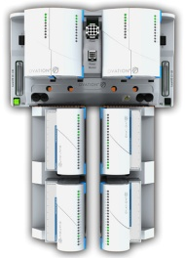
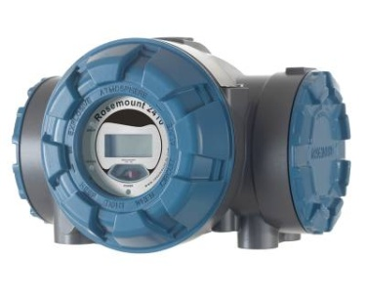

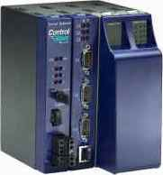
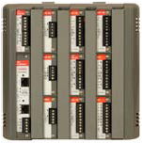

FOUNDATION fieldbus H1
The Future is Digital
Notes:
Foundation fieldbus H1 (commonly referred to as Fieldbus with capital 'F') is a bus technology specifically designed for process control to connect instruments such as transmitters and valves for control and monitoring of pressure, temperature, level, flow, pH, and conductivity etc. Fieldbus communication is an interoperable standard (IEC 61784-1 profile 1/1 of IEC 61158 type 1) meaning third-party devices and networking accessories can be used in Emerson systems, and that Emerson devices can be used on third-party systems. The technology is owned by the Fieldbus Foundation. Control systems, devices, and accessories are rigorously interoperability tested by the Fieldbus Foundation to ensure parts from different manufacturers will work together.

Slide 2

Marshalling Hardwired Analog Signals

Slide 3
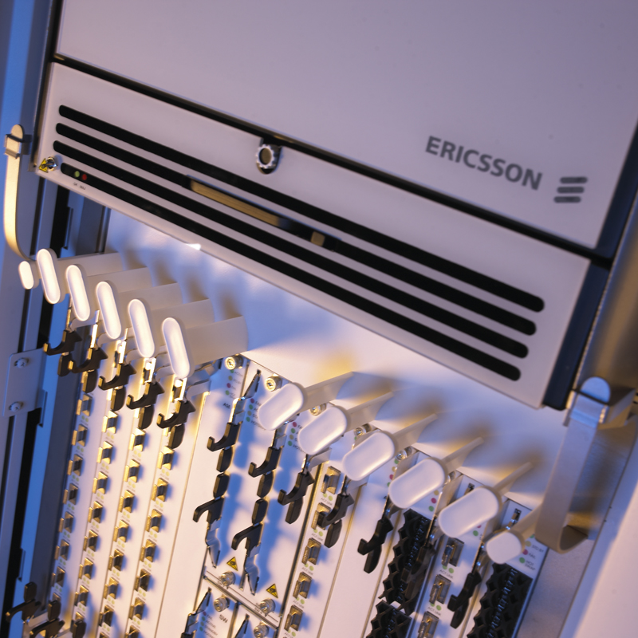
Virtual Marshalling of Digital Signals
Notes:
Today voice and data travel together over digital networks, all switching/marshalling is ‘virtual’

Slide 4
Topics Covered
Fieldbus basics
Fieldbus benefits
Project benefits
Operation & maintenance benefits
Making fieldbus easy
Easy to deploy
Easy to operate
Easy to run & maintain
Specifying fieldbus

Slide 5
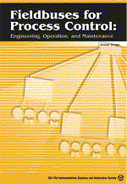
Fieldbus Started With a Simple Idea
Reduce cabling
Simplify signal marshalling
Digital closed loop control
Multi-vendor interoperability
All devices intelligent
Faster commissioning
Predictive maintenance based on diagnostics
Liberating plants from proprietary protocols
Notes:
The benefits of completely digital automation without the limitations of 4-20 mA and On-Off signals are enormous. The purpose of FOUNDATION fieldbus is to take automation to the next level by making control loops completely digital from end-to-end, transmitter to positioner, without intermediate analog signals, and by communicating multiple signals from multiple devices on the same pairs of wires, and enabling new more powerful devices including intelligent two-wire On-Off devices with predictive diagnostics.

Slide 6
Fieldbus Basics

Slide 7
Fundamental Properties of Digital Technology: Infinite Possibilities
Digital signals can be transmitted perfectly, without error
Digital signals can be repeated and replicated infinitely
Zero marginal cost
Once the investment in the network for the first signal has been made, many signals can be added at little or no incremental cost
Easy to change
Need detailed standards
0
1
0
1
0
1
0
1
0
1
0
1
0
1
0
1
Notes:
Harvard Business Review, November 2014, “Digital Ubiquity: How Connections, Sensors, and Data Are Revolutionizing Business”
http://hbr.org/2014/11/digital-ubiquity-how-connections-sensors-and-data-are-revolutionizing-business/ar/1
fundamental properties of digital technology that makes it transformational
“(1) Unlike analog signals, digital signals can be transmitted perfectly, without error.”
“(2) Moreover, digital signals can be replicated indefinitely”
“(3) Once the investment in network infrastructure has been made, the page can be communicated to the incremental consumer at zero (or almost zero) marginal cost.”
Error free
Infinitely reproducible
Zero marginal cost
Infinite connection, aggregation, and abstraction
Dependent on standards and tools

Slide 8
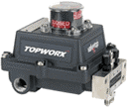


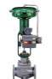

FOUNDATION fieldbus H1 Basics - Hardware
31.25 kbit/s (25X)
Pure digital control
Bus power on same two wires: 9-32 VDC
Intrinsically safe or non-incendive; zone 0/1/2
1900 m total, 120 m spurs
Shielded twisted pair cable
Real-time and non-real-time
Time synchronized & scheduled
Multi-vendor interoperability
Multidrop: typical 10-12 devices; 3 I/O per device
Permits temporary masters
Interface (LAS)
Bus Power
Terminator
Spur
JB
C
Trunk
T
LAS = Link Active Scheduler
T = Terminator
C = Coupler
>> 30 I/O signals per pair of wires
Notes:
Does not need coax cable
Coupler makes it easy to plug in an additional device without affecting other devices
Foundation fieldbus H1 is a bus technology specifically designed for process automation to connect instruments such as transmitters and control valves. Foundation H1 is multidrop permitting many devices to be connected on the same single pair of wires. Power for the instruments is supplied on the same two wires and can be intrinsically safe or non-incendive if required in a hazardous area. Foundation H1 is pure digital communication eliminating the need for 4-20 mA thus enabling digital closed loop control. Foundation H1 provide full access to information and functionality in the device including deterministic hard real-time monitoring and control as well as calibration and diagnostics. The bus can run the long distance between the control system and the instruments and allows devices to be connected by long spurs. Foundation H1 eliminates the need for remote I/O in hazardous areas where it is difficult to service.
Because Foundation fieldbus H1 is a bus technology used by all leading manufacturers of process automation systems, instrumentation, and accessories which are all rigorously interoperability tested, users are assured that devices from different suppliers will work together.
Since multiple devices connect to the same bus, the wiring and installation effort can be reduced. Fieldbus has an advantage over field-mounted remote I/O for hazardous areas in that wiring can be reduced and fieldbus interfaces can still be mounted outside the hazardous area where maintenance is easier.
Bus topology and tree topology or a combination thereof are supported. Devices can connect through long spurs thus simplifying maintenance. A bus can consist of a single or multiple segments. A pseudo star topology network consists of several segments joined by repeaters.
A bus can be hardened by dividing it up in smaller segments with fewer devices each using repeaters, with spur current limiters, or through ring-like topologies.
Foundation fieldbus H1 supports multiple masters on the same bus where one is selected as Link Active Scheduler (LAS). This permits flexible redundancy and backup solution to be designed.

Slide 9
Many Bus Power Options to Optimize for Different Needs
Dsgn | Spur (Device) | Trunk | Device Zone | Live Work on Trunk | Live Work on Spur | Redundant Power | Devices (@20 mA) | Remarks
1 | Exd |  | Zone1 | N | N | Y | 16
2 | Exia, Entity, IIC |  | Zone 0 | Y | Y | N | 3
3 | Exia, FISCO, IIC |  | Zone 0 | Y | Y | N | 5
4 /14 | Exib, FISCO IIC |  | Zone 1 | Y | Y | N / Y | 6 | Mult-seg
5 / 15 | Exib, FISCO IIB |  | Zone 1 | Y | Y | N / Y | 13
6 | Exia, FISCO, IIC | Exe | Zone 0 | N | Y | Y | 16 | HPT/HET
7 | Exia, Entity, IIC | Exia, Entity, IIB | Zone 0 | Y | Y | N | 16
11 | N.I. (Entity), IIC | NNA, IIC | Div 2 | N | Y | Y | 16
16 | Exic, Entity, IIC | ExnA, IIC | Zone 2 | N | Y | Y
17 | Exic, FISCO, IIC | ExnA, IIC | Zone 2 | N | Y | Y
Hazardous areas are same as for hardwired
Same protection options: ia, ib, ic, NI, d, and e
Same zones/class/division: 0, 1, 2
Same gas groups: IIC, IIB, A, B, C, D etc.
Notes:
FOUNDATION fieldbus is a two-wire bus combining power and communication for multiple devices on the same pair of wires thus reducing wiring. Long cables up to 1.9 km are possible, reaching devices far into the field, and spur cables can branch out as far as 120 m permitting versatile topologies.
FOUNDATION fieldbus was designed for process control where many industries have explosive atmospheres. For hazardous areas, bus power with traditional intrinsic safety as well as the optimized Fieldbus Intrinsically Safe Concept (FISCO) for Zone 0 and Zone 1 (Division 1) is available and permits easy live work. Optionally safety barriers can be mounted in the field. Other hazardous area power solutions include traditional non-incendive Division 2.
Fieldbus cable can be routed in flame proof (explosion proof) conduits and junction boxes. Many solutions for intrinsic safety using entity and FISCO (Fieldbus Intrinsically Safe Concept) models for both Exia and Exib and gas groups IIB and IIC, Non-incendive using entity. Field mounted barriers and limiters based on increased safety Exe (increased safety) and ExnA (non-sparking normally non-arcing) trunks are available. Using these protection techniques Zone 0, 1, and 2 (division 1 and 2) can be covered.

Slide 10
Most “Digital Control Systems” Aren’t
Hardwired
Fieldbus
Process
Discrete
Process
Discrete
Analog
(4-20 mA)
Binary
(On-Off)
DCS
(Real-time control)
Digital
(FF)
Digital
(FF)
Digital (HART)
None
IDM
Digital (FF)
Digital (FF)
(Device Management)
Analog
Digital
Digital
Digital
Digital
Digital
Analog
If it’s not fieldbus, it’s not a digital control system
Digital
Positioner
Digital
Positioner
Digital
Discrete
Transmitter
Digital
Transmitter
Dumb
Digital
On-Off Valve
Controller
On-Off Valve
Controller
Notes:
There is no HART control system, only HART device management system
Don’t build your plant old
CD-LP-CD-LP-CD
CD-CD-CD-CD-CD
Its like: Type, print, send, scan, reply, print, send, scan... or just email...
10

Slide 11

















Fieldbus in the Largest, Most Sophisticated Projects in the World
Suncor Oil Sands Ft. McMurray (FF) one of the largest oil sands projects ever
Wyeth – largest bio tech facility
SECCO – largest ethylene complex (FF)
Bayer MaterialScience – largest chemical site (FF)
BP three US refinery automation upgrades BP largest refinery
Shell Deer Park Refinery – first FF hot cutover FCC upgrade
Saudi Polymers large integrated petrochemical facility
Shell Malampaya deepwater platform FOUNDATION Fieldbus
Fujian Refining and Ethylene – China’s largest integrated refining / petrochemical facility
Atlantic LNG – first FF LNG train
Qatargas – world’s largest LNG trains
Ravensthorpe – largest FF mining facility
Celulosa Arauco – largest pulp mill (FF)
Petrobras COMPERJ
Largest SA MAC
Notes:
As a sampling, Emerson has been trusted with executing the largest, most complex projects in the world.
Emerson has helped our customers be successful all over the world in the process industries.
Emerson: Successful projects call for partnering with a financially strong, globally experienced organization that delivers the best available technology to assure efficient plant operations.
Full Service: Services span a wide range of commercial and contracting strategies including MIV, PAS, ICSS and MAC projects.
Delivering Results: Customers typically save over 30% on installed costs with the PlantWeb digital plant architecture and can improve plant efficiency by 2% or more.
Experience: We have experience implementing the best leading edge technology, PlantWeb, in some of the largest automation projects in the world.
Consistent Excellence: We continuously invest in our Project Management Office (PMO), driving best practices, improvement, service excellence and consistency around the world.
Great People: We train our professionals as technologies and methods evolve, and we have experts in each served industry.

Slide 12
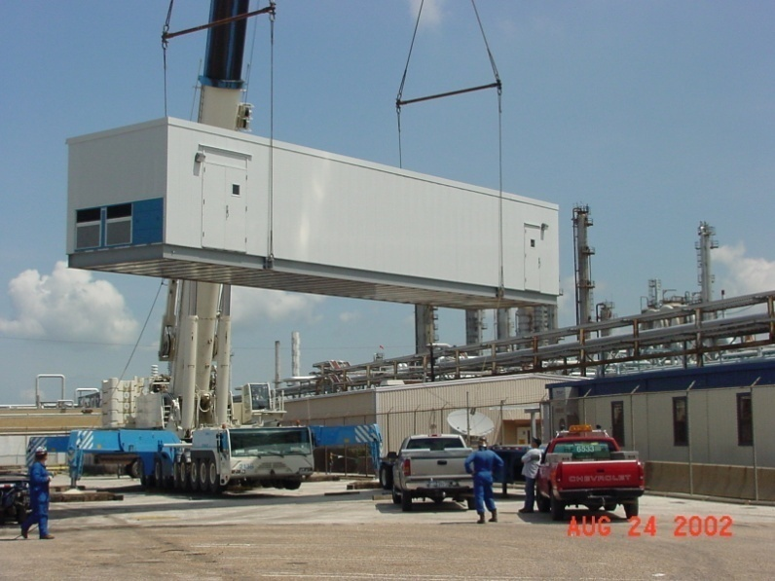

Shell Deer Park (USA)
Full Integrated Refinery & Chemical Plant
Separates Crude Oil for Gasoline, Diesel & Chemicals
Sixth Largest Refinery in the USA
Strategically Located on the Houston Ship Channel
Built in 1929 Before the USA Great Depression
Complete MAC Services
Modernization of Old Competitive Equipment
Hot Cutover of All Process Units
Process Control Systems
Emergency Shutdown Systems
Remote Instrument Buildings
Foundation Fieldbus Digital Field Network
Pressure Transmitters
Temperature Transmitters
Flow Measurement
Digital Valve Controllers
Control Valves

Slide 13



Qatargas (Qatar)
Liquefied Natural Gas (LNG)
Cryogenically Freezes Natural Gas (minus 280 Deg F)
Reduces Volume of Natural Gas by 600 Times
Uses Marine Loading for Delivery to Global Customers
Process Found at Stranded Gas Reserves w/o Pipelines
Complete MAC Services
Process Control Systems
Emergency Shutdown Systems
Fire & Gas Detection Systems
Plant Operations Information System
Lab Information System
Advanced Process Control
Pipeline Management System
Transmitters
Digital Valve Controllers
Control Valves

Slide 14
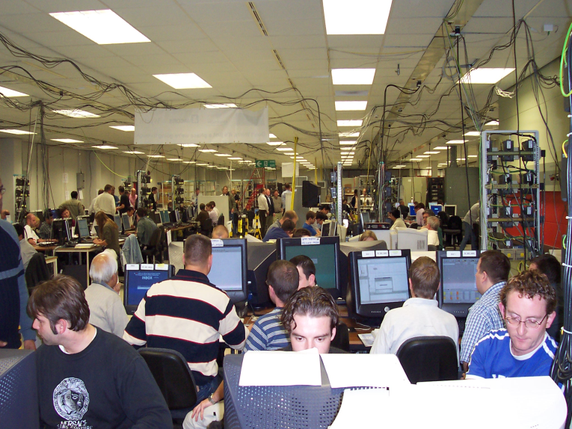
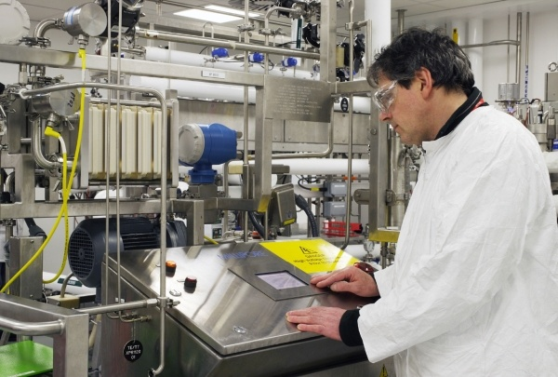

Wyeth (Pfizer) Grange Castle (Europe)
Produces drug for rheumatoid arthritis
Engineering team included 18 nationalities
Peak of 240 people working on project
11 parallel test teams (over 100 people testing)
Process Control Systems
Asset Management Solution Software
Foundation Fieldbus Digital Field Network
Pressure Transmitters
Temperature Transmitters
Flow Measurement

Slide 15



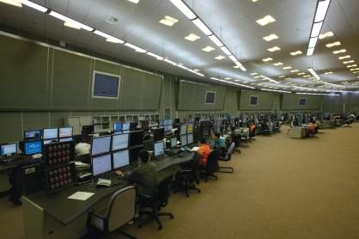
SECCO (China)
Produces Poly-Ethylene and Poly-Propylene
Feedstock Produced From Light Hydrocarbons
Process Uses Catalytic Conversion of Feedstock
Final Process Produces Solid Pellets for Rail & Shipping
End Product Used for Global Plastics Market
Complete MAC Services
Process Control Systems
Emergency Shutdown Systems
Asset Management Solution Software
Foundation Fieldbus Digital Field Network
Pressure Transmitters
Temperature Transmitters
Flow Measurement
Digital Valve Controllers
Control Valves

Slide 16
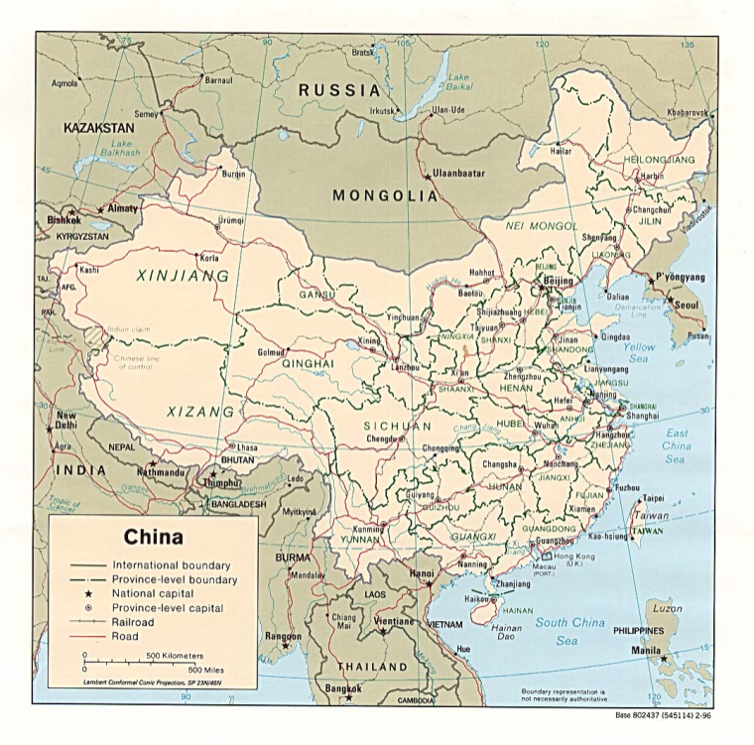


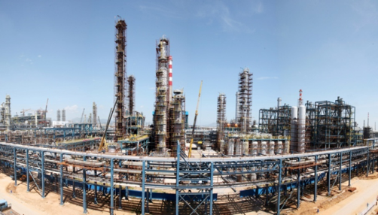

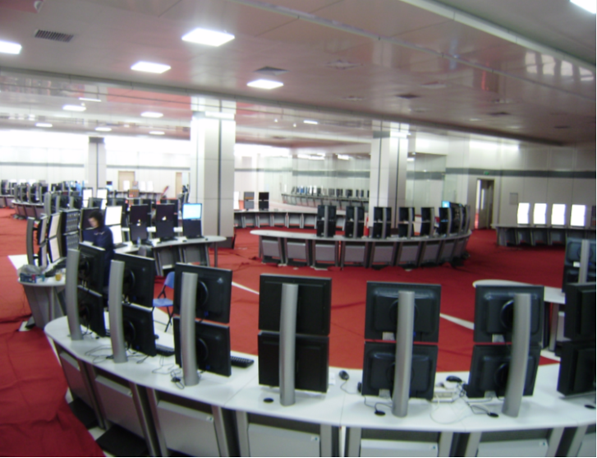
Fujian Refining & Ethylene Project (China)
Integrated Refining & Petrochemical Complex
Located in Quanzhou, China (Fujian Province)
Designed to Refine Sour Saudi Arabia Crude Oil
240,000 Bbl/Day Refinery - 800K TPA Ethylene
400K TPA Propylene, 700K TPA Paraxylene
51,000+ Hard Wired I/O
Main Automation Contractor Services
Complete FEED Design by Emerson
Complete Project Execution Services
Start-Up & Commissioning Support
Integrated Control and Safety Systems
Foundation Fieldbus (DCS), HART (SIS)
Pressure, Temperature, Flow, Level Measurement
Control Valves w/Digital Valve Controllers
Analyzer Package w/Foundation Fieldbus

Slide 17
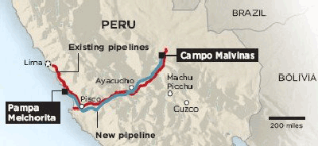


Peru LNG (Peru)
Emerson Preselected by Hunt Oil
EPC Contract Executed by CB&I London
Single Train Air Products MCHI Process
Commissioned in 2010
Inlet Gas Feed From Camisea Blocks
DeltaV Distributed Control System
DeltaV Safety Instrumented System (ESD, F&G, HIPPS)
Fisher Control Valves
Asset Management Solution Software
Rosemount Pressure & Temperature Transmitters
Micro Motion Flowmeters
Foundation Fieldbus Architecture
Operator Training Simulation System
Project Configuration Services
FAT Services
Site Support & Commissioning Services
Long Term Support Services

Slide 18
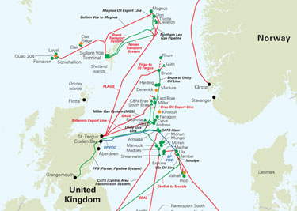

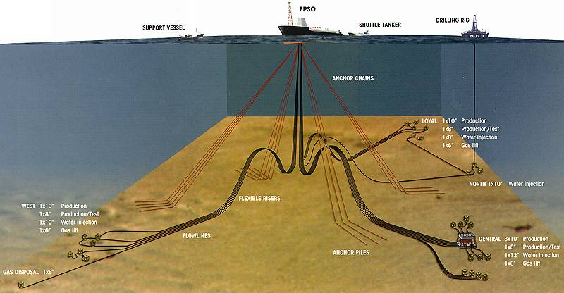
BP Quad 204 FPSO “Schiehallion” Shetland Islands
Floating Production Storage and Offloading (FPSO)
North East Atlantic – Harsh Environment
Multiple locations
Turret – France, Subsea – UK, Hull - Korea
Complete MAC Services
Part of Initial Project Design Team
Process Control Systems
Emergency Shutdown Systems
Asset Management Solution Software
Foundation Fieldbus Digital Field Network
Pressure Transmitters
Temperature Transmitters
Flow Measurement
Digital Valve Controllers
Control Valves

Slide 19


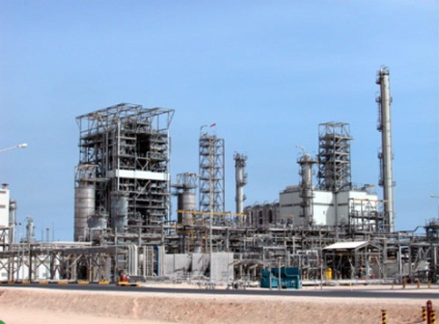

ChevronPhillips Chemical NCP (Middle East)
World Class Chemical Plant
Located in Jubail, KSA (Northeast Saudi Arabia)
Produces Polyethylene, Polypropylene & Polystyrene
US$5 Billion Grassroots Construction
Emerson Selected as Best Global MAC Provider
Emerson Scope Exceeded US$130 Million
Complete MAC Services
Process Control Systems
Emergency Shutdown Systems
Integrated Process Analytical System
Remote Instrument Buildings
Foundation Fieldbus Digital Field Network
Pressure Transmitters
Temperature Transmitters
Flow Measurement
Digital Valve Controllers
Control Valves
Regulators
QC3 Quality & Commissioning Package
EMR Industrial Automation
EGS Appleton
KOP-FLEX

Slide 20
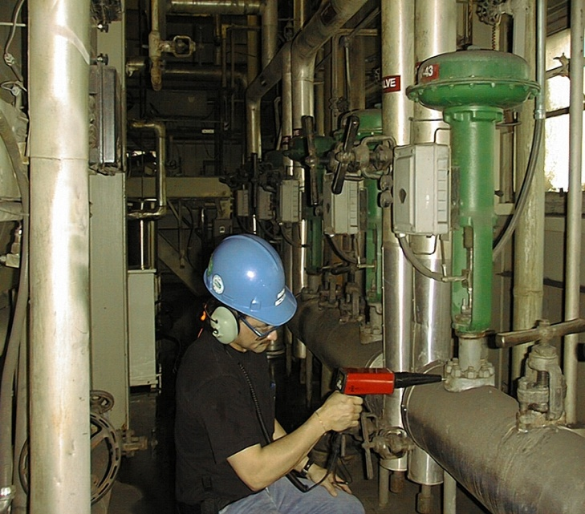


Petrobras REPLAN Refinery (Brazil)
Largest Petrobras Refinery
Strategically Located at Brazil largest consumer market
Production equals to 20% of Brazil refining production
Complex totals 9.1 square kilometers
DeltaV in all process units
Migration of Provox system in several units
Migration of old competitive systems
Safety System (DeltaV SIS)
Foundation Fieldbus Digital Field Network
Pressure Transmitters
Temperature Transmitters
Flow Measurement
Digital Valve Controllers
Control Valves
Guardian Support
Resident Engineers for 3 years

Slide 21
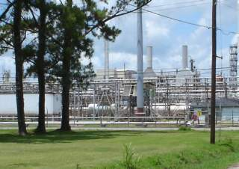


Motiva Norco Refinery (North America)
240kbpd Refinery, built in 1918 near New Orleans
Shell acquired in 1929
Shell/Saudi Aramco Joint Venture since 2002
1,000 employees and contractors
20th largest refinery in North America
Refinery East series of Projects 2004-2007
Full MAC/PlantWeb Implementation
All-Emerson solution
Full use of Predictive Intelligence
Highly documented
Highly acclaimed
Modernization of Old Competitive Equipment
Hot Cutovers
Simulation
Advanced Controls
Continuous improvement and expansion
Large Blender Project recently completed
Next big project: Tank Farm
Cat Cracker Project (2013-2014) will double system size

Slide 22
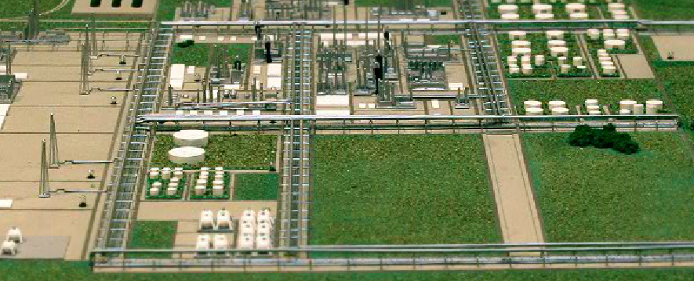
Petrobras COMPERJ – Petrochemical Complex, Brazil
DeltaV
FOUNDATION fieldbus

Slide 23

Shell Prelude FLNG, Australia – World’s Largest
Operated onboard
Managed from onshore – including maintenance: iOps
DeltaV
FOUNDATION fieldbus

Slide 24


Petronas FLNG, Malaysia – World’s First
DeltaV
FOUNDATION fieldbus

Slide 25
Fieldbus Project Benefits

Slide 26
Main Areas of Fieldbus Project Benefits
Lower hardware and installation cost: reducing cable, tray, junction boxes and associated labor
Multiple devices on the same pair of wires
Multiple real-time signals (per device) on the same pair of wires
One fieldbus device eliminates 3 hardwired I/O points without putting I/O cards in the field
More powerful two-wire loop powered devices like tank gauging systems, multi-channel temperature transmitters, and intelligent on-off valves
Reducing system footprint and weight
Dramatic reduction of I/O cards: 128 virtual I/O in one card
Eliminating marshalling cabinets
Reduced engineering time and cost
Elimination of I/O card type selection
Elimination of safety barrier type selection
Elimination of signal marshalling simplifying engineering
Virtual Marshalling: easy addition of devices to accommodate changes late
Virtual Marshalling: easy incorporation of unused real-time signals
Virtual Marshalling: change device type: e.g. on-off valve to control valve or MOV
Reduced commissioning time and cost
No 4-20 mA five point loop test
Automatic loop check documentation
Automatic device configuration download and easy verification
Easy migration path to future APL (Ethernet) devices
Notes:
If the intention is to go through all detail slides, then quickly gloss over this slide just saying there are 4-5 major areas of project benefits
Multiple devices on the same pair of wires reducing cable, tray, junction boxes and associated labor
Multiple real-time signals (per device) on the same pair of wires dramatically reducing cable, tray, junction boxes and associated labor: one fieldbus device eliminates 3 hardwired I/O points without putting I/O cards in the field
More current for more powerful two-wire loop powered devices like tank gauging systems, multi-channel temperature transmitters, and intelligent on-off valves for further wire reduction
Dramatic reduction of I/O cards reducing system footprint and weight: 128 virtual I/O in one card
Elimination of I/O card selection (4-20 mA in, 4-20 mA out, discrete DC in, AC in, dry contact, DC out, relay, AC out, thermocouple, RTD, and pulse/frequency etc.) simplifying engineering
Elimination of safety barrier selection simplifying engineering
Elimination of signal marshalling simplifying engineering and eliminating marshalling cabinets
Virtual Marshalling: Addition of devices to accommodate changes late in the project at a click of a button
Virtual Marshalling: Incorporation of unused real-time signals in devices late in the project or after startup at a click of a button
Virtual Marshalling: Change to other device type: e.g. on-off valve to control valve or MOV late in the project at a click of a button
Automatic loop check documentation
Automatic device configuration download and easy verification
No 4-20 mA five point loop test
Easy migration path to future APL (Ethernet) devices

Slide 27
Multidrop: Minimize and Simplify
Hardwiring
Familiar but tedious design
“Hard”, inflexible
Large footprint
Labor intensive
Fieldbus
Simpler “new” design
Flexible
Fewer cabinets
Simpler installation
D
I
D
O
A
I
A
O
Let’s study each one...
FTA
Marshalling
P/S
24
24
2
JB
FJB
C
2
2
2
22
T
M
6
S
6
Notes:
Fieldbus is multidrop, meaning several devices are connected in parallel on the same single pair of wires. All field devices in the plant do not sit on the same fieldbus. On average there are ten devices on the same pair of wires. The bus can run the long distance between the control system and the instruments. Power for the instruments is supplied on the same two wires and can be intrinsically safe or non-incendive if required in a hazardous area. Fieldbus is pure digital communication running at 31.25 kbit/s, enabling digital monitoring and closed loop control. Devices can be removed and added under power. A large variety of networking accessories such as cable, fieldbus power supply, safety barrier, current limiter, and coupler are available from many third-parties complete the system. Two terminators are required but are typically already built into power supplies and couplers. Redundant power supplies and interface cards are supported.
Multiple masters are supported, but only one, called Link Active Scheduler (LAS) usually the system's primary interface card is active at any one time. Each device is identified by an address automatically assigned by the LAS. A handheld field communicator can be connected without interrupting real-time control. Communication is deterministic (response time is known, not random). Three communication relationships are supported: scheduled publisher/subscriber for real-time I/O, client/server for non-real-time central configuration and diagnostics, and report distribution for alerts. A schedule ensures that non-real-time communication does not delay real-time communication. Publisher/subscriber communication is peer-to-peer meaning any device can talk directly to any other.
Fieldbus applications are configured in function blocks (IEC 61804-2 Ed. 2) and devices in transducer blocks. Control can be executed in the field devices or in the control system. central access to all information and functionality in the device including setup, calibration trim, and diagnostics is provided and presentation formatted by device manufacturer using Electronic Device Description Language (EDDL, IEC 61804-3). Time synchronization sets real-time clocks in all devices enabling I/O sampling and control in all devices to be synchronized and all alerts to be time-stamped in the device. Alerts include process alarms and diagnostic alarms as well as configuration change event notification. Loading only a few loops per fieldbus ensures control response period of 250 ms or lower if required. Configuration, diagnostics, and other functions are called intelligent device management, usually a part of asset management system (AMS)

Slide 28
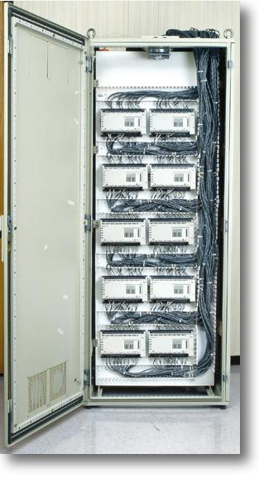
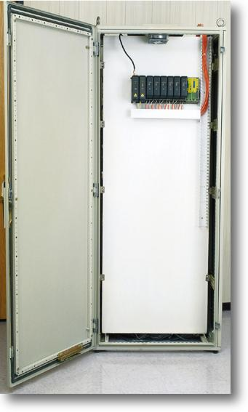
Lower Cost: - Fewer Cards and Cabinets
Hardwired
One I/O channel per signal
One barrier per signal
One pair of wires per signal
Signal conditioners and relays
Fieldbus
Fewer I/O cards
Fewer safety barriers
No marshalling and termination panels
Reduced footprint, weight, power, and heat load
320 signal cabinet with hardwired architecture
250 device cabinet with fieldbus architecture
110 devices
750 signals
Notes:
Hardwired:
Hardwired: 40 cards x 8 channels/card = 320 signals; / 3 signals/device = 106 devices
Fieldbus: 8 cards x 2 ports/card x 16 devices/port (max) = 256 devices; x 3 signals/device = 768 signals

Slide 29
Reduced Cable an Tray
Hardwired
Fieldbus
100 devices = 300 signals
6 x 50 pair hardwired point-to-point
Cannot be expanded
100 devices = 300 signals
1 x 10 pair fieldbus
Expandable to 160 devices
and 480 signals

Slide 30
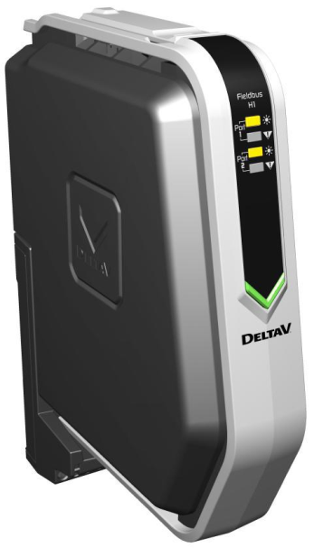
The FOUNDATION fieldbus H1 Card - Virtual I/O or “Soft I/O”
2 H1 ports per card
16 devices per port (max)
“10+2” typical
150 ms macrocycle
Redundancy
Ability to perform control
Extensive set of function blocks
Synchronized with macrocycle
Optional fieldbus power
‘96 Channel I/O Card’
2 ports
16 devices per port
3 signals per device (average)
Notes:
2 ports * 16 devices * average 3 signals per device = 96 I/O signals per card
Note that 96 function blocks are not required because devices such as on-off valves, control valves, and electric actuators / motor operated valves (MOV) support all control and feedback signals in a single block and multi-channel transmitters support MAI blocks etc.
DeltaV 2-port card supports 96 function blocks per card. 4-port card supports 128 function blocks per card

Slide 31
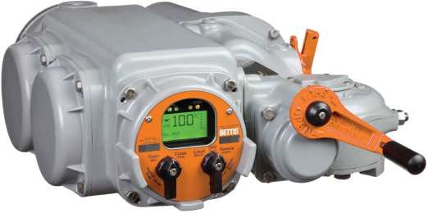
Reduced I/O Count and Wiring on Complex Devices: Fully Integrated
Hardwired
Lots of wiring and I/O cards
Fieldbus
Multiple signals share the same two wires
Reduces wiring for electric actuators
Cores | I/O | Description
4 | 3 DO | Open/stop/close control
2 | 1 AO | Desired valve position control
2 | 1 DO | Emergency shut down
3 | 2 DI | Valve position status (limit switches)
2 | 1 AI | Percentage open
1 | 1 DI | Available for control
1 | 1 DI | Local/remote switch
1 | 1 DI | Motor running open direction
1 | 1 DI | Motor running closed direction
1 | 1 DI | Torque switch tripped
2 | 1 AI | Percentage torque
1 | 1 DI | Motor thermostat tripped
1 | 1 DI | Battery condition low
22 | 16 ch | TOTAL
With hardwired, many device features become too costly to use so MOV is not fully integrated
Notes:
Reference: Rotork Pacscan brochure
Many field devices would require more than one pair of wires... Save more
With hardwiring many device features go unutilized because the wire and I/O required becomes too costly
Signal Cores System I/O Description
1 4 3 DO Open/stop/close control
2 2* 1 AO Desired valve position control
3 2 1 DO Emergency shut down
4 3 2 DI Valve position status (limit switches)
5 2* 1 AI Percentage open
6 1 1 DI Available for control
7 1 1 DI Local/remote switch
8 1 1 DI Motor running open direction
9 1 1 DI Motor running closed direction
10 1 1 DI Torque switch tripped
11 2* 1 AI Percentage torque
12 1 1 DI Motor thermostat tripped
13 1 1 DI Battery condition low
TOTAL 22 9 x DI, 3 x DO, 2 x AI, 1 x AO

Slide 32
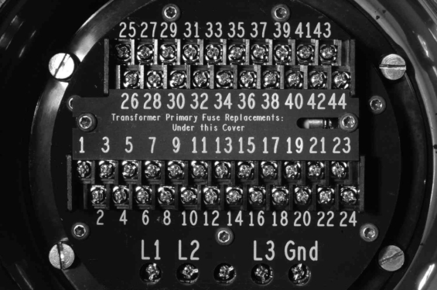
Fieldbus Eliminates I/O Cards and Terminations
The hardwired MOV has 44 screw terminals for signals
Fieldbus uses only 2 of these terminals for all signals

Slide 33
Eliminate Proprietary Protocols, Gateways, and Software
Proprietary Bus
Vendor dependency
Gateways, mapping…
Fieldbus
Standards-based
Simple architecture
DEVICE
MGMT
OPERAT.
CONSOLE
M.O.V.
CONFIG.
DEVICE
MGMT
OPERAT.
CONSOLE
F
F
F
F
M
B
M
B
F
F
F
F
GATEWAY
FIELDBUS
MODBUS
FIELDBUS
P
T
M
M
P
T
M
M
PROPRIETARY
P
T
M
M
P
T
M
M

Slide 34
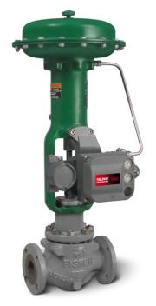
One Device is Not One I/O Count
The average device may have 3 signals
Measurement, control, and feedback etc.
Fully integrated
Not even counting internal variables
Kind of Device | I/O Count
Valve positioner (limit switch feedback) | 3
Valve positioner (position transmitter feedback) | 2
Electric actuators / Motor Operated Valve (MOV) | 16
On-Off valve | 3
Coriolis mass-flowmeter | 3
Magnetic flowmeter | 4
pH analyzer | 2
Guided wave radar level transmitter | 2
Process gas analyzer | 5
=3

Slide 35

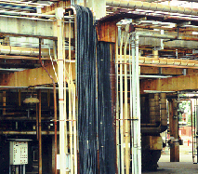
Lower Cost: - Simpler Installation
Hardwired I/O
A simple device requires one pair of wires each all the way to the rack room
Most devices require multiple pairs each
FOUNDATION fieldbus
Fewer cable trays and conduits to install
Fewer cable glands to assemble
Fewer cables to lay
Fewer wires to cut, strip, label, crimp’ and connect – many points
Notes:
Wiring Savings: There are substantial labor and hardware installation savings associated with fieldbus compared to a traditional DCS installation. Wiring saving are a combination of material and labor costs for installing wire, cable tray, conduit, marshalling cabinets, junction boxes, terminal blocks, and IS barriers.
In the installation phase, high cost savings are realized from the multi-drop wiring capability of fieldbus. With FOUNDATION Fieldbus technology, one cable can run from the I/O card to the marshalling panel and out to a junction box. This single twisted pair cable will support up to 16 complex devices. Using traditional 4-20 mA I/O, each signal would require a dedicated pair of wires from the I/O card to the field device. This results in an 83% to 98% (16 complex devices per segment) reduction of the total required length of single, twisted pair cable. Less signal wire translates to less labor required to make screw connections.
The total wiring cost reduction typically ranges from 40% to 60%! This includes material and labor costs for installing marshalling panels, junction boxes, cable tray, cable and conduit

Slide 36
Lower Cost: Fewer Connections to be Made
Devices
FTA
I.S. Barrier
I/O
Assembly
+
+
-
-
1
1
+
+
1
+
+
1
1
Hardwired
160 connections
8 barriers
Fieldbus
55 connections
1 barrier
1
-
-
-
2
2
-
2
2
+
+
3
3
3
3
2
+
-
+
-
+
-
4
4
4
+
+
-
5
5
-
-
-
5
6
+
+
6
6
+
7
3
-
-
7
7
+
+
-
8
8
+
8
-
-
9
-
9
9
4
10
+
+
10
10
+
+
+
11
11
-
-
11
-
-
-
12
+
12
12
5
13
-
+
13
13
+
+
+
14
14
+
-
14
-
-
-
15
-
15
15
6
16
+
16
16
+
+
17
17
-
+
17
+
-
-
+
18
-
18
18
-
7
-
19
19
19
+
+
20
20
+
20
-
-
+
21
-
21
21
-
22
8
22
22
+
+
23
23
23
-
-
24
+
24
If devices have more signals, such as position feedback or auxiliary inputs, the reduction becomes even more dramatic.
24
+
-
-
16
48
48
32
16
16
27
6
4
2
Field
Junction Box
Marshalling Cabinet
Notes:
Fewer wires to cut, strip, label, ferrule, and screw
Although Emerson has IO modules with built-in barriers, many DCS do not and therefore need separate barriers as illustrated here.
Devices: 16 = 8 devices x 2 terminals (+ and -)
FJB (analog): 48 = 8 devices x 3 terminals (+, -, and shield) x 2 sides (field and home-run)
FJB (FF): 27 = 8 devices x 3 terminals (+, -, and shield) (field side) + 3 terminals (+, -, and shield) (home-run side)
Marshalling (analog): 48 = 8 devices x 3 terminals (+, -, and shield) x 2 sides (home-run and system)
Marshalling (FF): 6 = 3 terminals (+, -, and shield) x 2 sides (home-run and system)
IS barrier (analog): 32 = 8 devices x 2 terminals (+ and -) x 2 sides (home-run and system)
IS barrier (FF): 4 = 2 terminals (+ and -) x 2 sides (home-run and system)
IO assembly (analog): 16 = 8 devices x 2 terminals (+ and -)
IO assembly (FF): 2 (+ and -)
Some IS barriers needs power supply! At least 3-4 wires on safe side. However, some IS barriers are loop powered and therefore 2-wire as shown here...

Slide 37
Field Junction Box
Conventional
Remote-I/O
Fieldbus
0.5 m x 0.3 m x 0.2 m
8 kg
No power required
~12 signals
1 m x 1.2 m x 0.4 m
120 kg
AC power (redundant or UPS)
~100 signals
0.5 m x 0.3 m x 0.2 m
8 kg
No power required
~30 signals (~12 devices)

Slide 38
Simplify I/O: Hardware Standardization Through Software-Based Customization
Hardwired I/O
A plethora of different hardwired signals
A bewildering array of I/O card types
Segregate signal types for each device
Bring device signals back together again in software
Fieldbus is Soft I/O
One type of interface card for all kinds of devices:
Sensing
Actuating
“Analog”
Discrete
Two ports per card
Max 32 devices
> 96 I/O signals
No need to segregate signals
DO
Iso
DO
Rel
NC
DO
AC
DI
AC
DI
DC
Low
AI
AO
I
T/C
DO
High
RTD
H1
DI
DC
DO
Rel
NO
DI
DC
Iso
AO
V
DI AC
Notes:
4-20 mA input two-wire loop power
4-20 mA input four-wire separate power
RTD/ohms 2-wire
RTD/ohms 3-wire
RTD/ohms 4-wire
TC/mV
4-20 mA output
Voltage output
NAMUR DI
DC low-side DI
DC Isolated DI
DC Isolated Auxiliary power DI
AC Isolated DI
AC Isolated Auxiliary power DI
DC high-side DO
DC Isolated DO
DC Isolated Auxiliary power DO
AC Isolated DO
AC Isolated Auxiliary power DO
Relay NO
Relay NC
H1: two ports per card, 16 devices each = 32 devices, average 3 devices per port = 96 signals per card

Slide 39
Handle Late Changes Better
Hardwired
Wait for final definition of devices and signals, then build
Fieldbus
Interface card that fits any device and signal
Standard cabinets
AI
DODC
DI
CO
DI
NA
DI
CO
AO
DODC
DI
CO
FF
H1
FF
H1
FF
H1
FF
H1
FF
H1
FF
H1
FF
H1
FF
H1
AO
AI
DODC
DI
NA
DI
NA
DI
CO
AI
AI
FF
H1
FF
H1
FF
H1
FF
H1
FF
H1
FF
H1
FF
H1
FF
H1
Hardwired: 320 Signals
Fieldbus: 320 Devices
AI
AO
DI
NA
DI
CO
DODC
AO
DI
NA
AO
DO
AC
DI
AC
DO
RE
DO
RE
DI AC
DI
AC
DI
AC
DI AC
DO
AC
DI AC
DO
RE
DO
RE
DO
AC
DI
AC
DI AC
DO
AC
Notes:
More than a dozen hardwired card types:
AI
AO
DI-NAMUR
DI-Contact
DO-Transis.
DI-AC
DO-Relay
DO-Triac

Slide 40
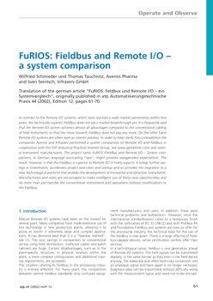
Wiring and Installation Savings
Fieldbus and Remote I/O System (FuRIOS)
Independent study by Aventis Pharma and Infraserv
Fieldbus saving over local/central I/O is about 20%
Fieldbus saving over remote I/O is about 5%
Back in 2002, fieldbus devices and hardware was expensive
Notes:
The independent study made by Aventis Pharma and Infraserv “Fieldbus and Remote I/O System” (FuRIOS). They found fieldbus saving over local/central I/O is about 20%. Fieldbus saving over remote I/O is about 5%. This was back in 2002 when fieldbus devices and hardware was expensive. Now more fieldbus products are available, and prices more competitive.

Slide 41
Easier Late Changes with ‘Late Binding’: - Fieldbus ‘virtual marshalling cabinets’
Hardwiring
More wires
Changed connections
More I/O cards
Change I/O card type
Change safety barrier type
Limited by multi-core spares
FOUNDATION fieldbus
No additional wires
No connection change
No additional I/O card
No I/O card change
No safety barrier change
No spare multi-core pairs used
Late changes:
Add a device
Change device type
Use additional signals (in devices)
Change power supply
Notes:
Late changes:
Add a device
Change device type
On-Off valve > control valve > electric actuator
Use additional signals (in devices)
Auxiliary measurement, position feedback, limit switches etc.
Since fieldbus marshalling is “soft”, it is more flexible to accommodate late changes. For instance, a fieldbus On-Off valve can be changed to a fieldbus control valve or electric actuator without requiring rewiring to a different I/O card or change of I/O card and subsequent drawing changes. For fieldbus, the devices connect to the same bus regardless of being analog or discrete in nature, input or output, regulatory or discrete, simple (single signal) or complex (multi-signal), because fieldbus makes no distinction between AI, DI, AO, and DO devices and scores of different sub-types of signal levels. All fieldbus devices are the same. This saves time and money for making changes and helps avoid mistakes. In case of late changes from EPC to system implementation, fieldbus devices are easy to add, remove, and change since the interface card remains the same. To add one device, plug its wire into coupler in field junction box, no barrier, no new IO card, expand bus up to 16 devices without adding interface capacity or increasing footprint, no marshalling wires. There is no need to redesign the I/O cabinets. The “soft” I/O binding is the key to the flexibility, as designers can be less specific about exact signal types at the engineering during the early design phases. If feedback from the valves is required, this can simply be included in the control strategy without additional drawings, wire, connections, or input cards etc. – fieldbus simply makes these kind of auxiliary signals from all devices available across the same two wires. The details are not needed in the initial design, the exact requirements can be finalize closer to install and startup. A fieldbus can be designed for 10 devices plus two spares, and then extend up to 13 or up to 16 devices due to changes still leaving two spares. Additional auxiliary control and monitoring signals from these devices can be included in the control strategy if required, simply from the engineering software without any additional wiring or different hardware. For fieldbus ten devices does not mean only ten signals, a simple transmitter may have just one signal, but an electric actuator, valve, flowmeter, or analyzer are supported with multiple signals. Fieldbus easily accommodates ten complex devices on one bus cable. That is, since fieldbus uses “soft” marshalling the limits are soft and flexible. Since with fieldbus, fewer cables are required, and all signals are “soft”, this drastically reduces the need for cross-wire marshalling, and also reduces risk of late project I/O change orders.

Slide 42
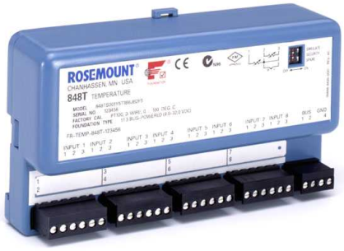
Multi-Channel Two-Wire Transmitter - Takes the Place of Eight Transmitters
65 %
Installed
Cost Savings
Installed Cost Per Point
Ideal for temperature profiling:
Reactors
Columns
Temperature
Input Card
with Comp. Wire
4-20 mA
Transmitters
AI Card
Temperature
Multiplexer
Multi-Channel
Transmitter
Shorter sensor wires
Less noise pickup
Reduced device count and cabling
Lower cost
Notes:
Update time for all 8 inputs is 1.5 seconds - monitoring
848T multi-channel temperature transmitter is ideal for temperature profiles, such as chemical reaction tanks and boiler plenum etc.
Direct wiring from sensor to I/O card: requires use of expensive temperature input card and either thermocouple extension wire (for T/C) or multiple wires (3 or 4 for RTD) for long distances which is expensive and labor intensive. For intrinsic safety, the special barriers are very costly. Moreover, the sensor signal is low and prone to noise pickup.
Low cost head-mounted "puck" and "cookie" transmitters requires use of 4-20 mA input cards and long wires.
Multiplexer is large and requires large field panel and separate power supply. Intrinsic safety can be a challenge.
848T multi-channel temperature transmitter mounts close to the sensors minimizing wiring cost and signal distortion. Multiple 848T multi-channel temperature transmitter can be connected on the same fieldbus and also together with other devices minimizing the long cable runs back to the control room.

Slide 43
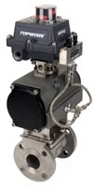
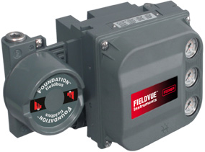
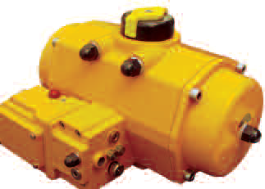
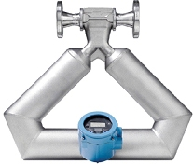
Simplify Complex Device Wiring - Liberating Internal Variables
Hardwired
Electric actuator (MOV)
Open, stop, close, ESD, overload...
Valve positioner
Setpoint, feedback, limit switches...
On-Off actuator
Solenoid, limit switches...
Mass flow transmitter
Mass, volume, density, temperature...
Fieldbus
Many wire pairs eliminated
Installation reduced
Many DI/DO cards eliminated
Fully integrated
25,000 I/O is 8,000 FF devices
Hardwired:
Multiple pairs
Per device
Bus:
Single pair
Many devices
Notes:
Many field devices would require more than one pair of wires... Save more
Fewer wires not only makes initial wiring and installation easier, it also makes future service easier as well. Any time a device has to be removed and replaced, there are fewer wires to disconnect and reconnect. Faster and less chance of errors.

Slide 44
Detail Design Made Simpler
Hardwiring
Many connections
Polarity sensitive
Signal-oriented
Signals grouped to I/O module based on type
Must know type and quantity of signal for each device to know I/O requirements
Every device has different Exi entity parameters
FOUNDATION fieldbus
Few connections
Polarity insensitive
Device-oriented
Signals for device grouped together
Just count devices
All devices have same Exi entity parameters

Slide 45



Lower Cost & Faster: - Device Commissioning
DICED:
Detection
Identification
Binding
Integration
Configuration
Checking
Documentation
Plug-n-Play
Only FF has automatic addressing
Devices are auto-recognized
Devices are auto-addressed
Devices identify themselves
Hardwired
2 hours / device for 2 technicians
Connect device
Five point loop check
Not limited
Linearity
Verify link to control strategy
Foundation fieldbus
25 minutes / device for 1 technician
Connect device
Check signal with tester
Automatic or drag-and-drop commissioning wizard
Notes:
Full loop check to validate calibration of transmitter current output, analog input card, analog output card, positioner current input, and integrity of the analog signal path is not required because there is no 4-20 mA. With FOUNDATION fieldbus devices are automatically detected and checked for "sign of life". Only a simple plausibility test has to be done because digital signals are not distorted.
FOUNDATION fieldbus devices are recognized by three mechanisms: a traditional node address for communication, a human readable device tag corresponding to the project P&I diagram, and a unique identifier allowing the system to automatically resolve any tag or address conflicts. The system automatically assigns the address to all devices, avoiding human errors such as address duplication associated with manually managed protocols, and saving time. Therefore technicians work based on tag and need not be concerned with address. Thanks to the unique identifier, multiple devices can be connected and commissioned at the same time. It is plug-'n'-play.
Commissioning: With fieldbus there is a dramatic reduction in commissioning and startup costs because there is more control room based activity, using fewer people and less time per point.
Commissioning and startup is defined as checking wiring, attaching devices, assigning the I/O to the correct place, confirming good signal communication and troubleshooting. Customers have reported estimates ranging from 3 to 5 man-hours to commission and startup a single traditional device. We have experienced a repeatable 90% reduction in this exercise using FOUNDATION Fieldbus.
Field wiring is checked one segment at a time instead of one device at a time. Physically attaching devices to a segment is done by simply by plugging in a quick connect fitting. The auto sensing and auto addressing features of DeltaV make assigning I/O lightning fast. The advanced Central diagnostics quickly confirm proper operation and minimize troubleshooting time
Fieldbus architecture dramatically reduces commissioning costs, including field labor costs for checking wire connections, attaching devices, verifying communications, and troubleshooting. Device installation and wiring checks
With the polarity-insensitive connections on Emerson Process Management FOUNDATION fieldbus devices, you don't have to spend time checking (and re-checking) polarity for each connection.
Communication checks
It's no longer necessary to send a technician into the field with a walkie-talkie as you manually "ring out" every device to verify its identity and communication links. Instead, devices are auto-sensed and auto-addressed in the DeltaV system as they are connected to the control network.
Troubleshooting
Fieldbus architecture's asset management system (AMS) software let you diagnose process and instrumentation problems Centrally. This capability means one person in one location can quickly detect and track down possible problems for an entire project.

Slide 46
Automatic Integration and Configuration Download
DICED:
Detection
Identification
Binding
Integration
Configuration
Checking
Documentation
Hardwired
Configure device parameters with handheld
Check device parameters with handheld
Fieldbus
Automatic configuration download
Compare configuration faster on computer

Slide 47
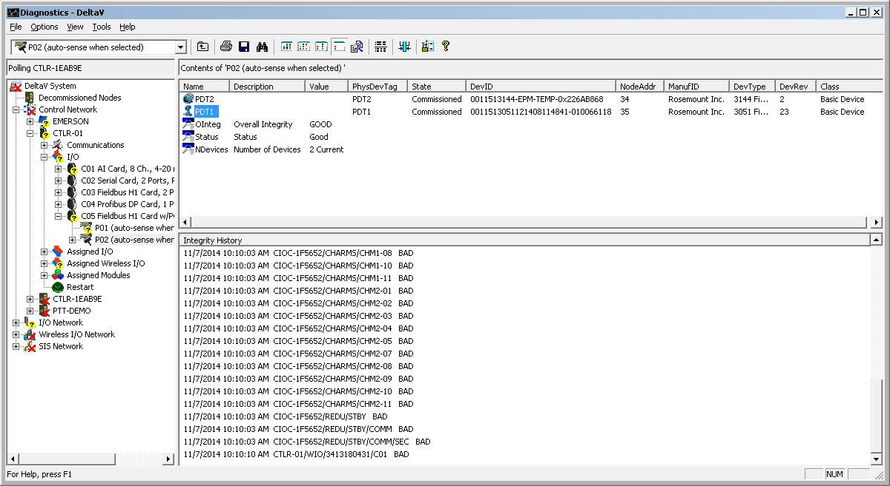
Automatic Commissioning Loop Check and Documentation
DeltaV Diagnostics checks that devices are properly commissioned and the communication signal OK; a digital loop check
Page lists all devices with card number, port, device tag, commissioning state, manufacturer, model/type, revision, unique ID, and address etc.
Also for discrete devices like on-off valves
Also for complex devices and MOV
DICED:
Detection
Identification
Binding
Integration
Configuration
Checking
Documentation
Notes:
MOV = Motor Operated Valve = Electric Actuator

Slide 48
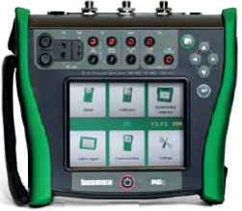
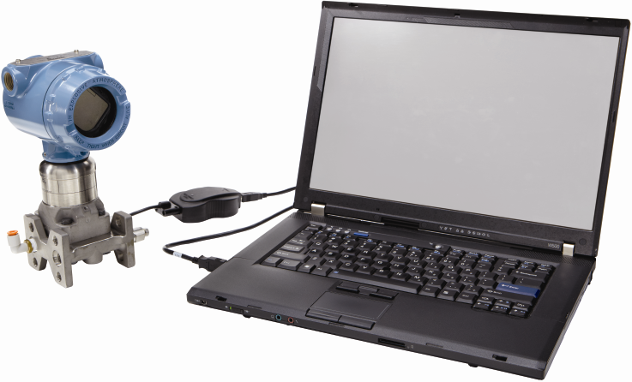
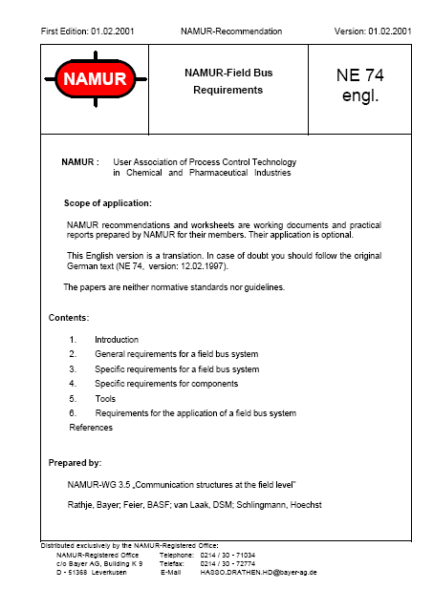
Same Tools as 4-20 mA Devices - Permits Temporary Portable Master
Only FOUNDATION fieldbus permits visitor devices to be connected ad-hoc to a running bus:
Handheld field communicator
Commissioning, configuration, check, etc.
Documenting calibrator
In-situ calibration
Laptop/tablet PC with software
Commissioning, configuration, check, etc.
Designed for process control
Notes:
Because Profibus does not support temporary master, the Beamex calibrator cannot be connected to a running bus. Either device must be removed or the PLC disconnected. Profibus was designed for factory automation, not process control where devices need to be periodically calibrated and checked...
Profibus support multiple class 2 master (which are used for parameters configuration) but the problem is the bus parameter need to be the same of both Host. I guess the chances of getting the master class 2 configuration wrong is so great that nobody is taking the risk of upsetting the bus. It is impractical to change these settings in a handheld as you move from one bus to another. This is why there is no handheld for Profibus (only for FF and HART) and why Beamex says their calibration must be connected offline for Profibus (but can be connected to running bus for FF). I find that for Profibus it is not a practical solution, so it is non-existent.
NAMUR NE 74 clause 3.1: “Non-cyclical communication requirements, such as parametrisation, configuration of field bus
devices, signal displays and the connection of hand-held terminals must not impede real time
transmission.”
NAMUR NE 74 clause 5.1: “In many cases, only active and passive communication by means of a universal hand-held terminal
allows for reasonable maintenance. It must be possible to insert this terminal almost anywhere in the
field bus without interrupting the communication.”
For FF there is a standardized address range for temporary masters and addresses are assigned automatically by the system, so you cannot set it wrong, so you will not crash the communication. The baud rate is fixed, so you cannot set it wrong, so you will not crash the communication... Another good thing about HART and FF is that the laptop interfaces connect directly to the device or bus cable to the device so field work is possible

Slide 49


Interoperability Tested Devices
Device
Physical Test
Conformance Test Kit (CTK)
Protocol
Interoperability Test Kit (ITK)
Blocks, Enhanced EDDL, Capability File (CF)
Host (Software, Handheld)
Host Profile Registration (HPR)
System test
Power Supplies (Conditioner, Barrier, Limiter)
Physical
Coupler [wiring block]
Cable
Interoperability
Technical White Paper Available
No surprises
Notes:
Host Interoperability Support Test (HIST) was discontinued 1 January 2009
The fieldbus foundation has established a rigorous conformance testing program called CTK and interoperability testing program called ITK for devices that want to claim conformance to the Foundation fieldbus H1 specification. This includes H1 devices and their support files. Bus power supplies have a separate test program. The configuration capabilities of control system engineering software as well as handheld communicators are evaluated by the HIST assessment program. All devices tested and registered by the Fieldbus Foundation receive the official Foundation "check mark" insignia.
ITK tests:
Initial Device Setup
PD Tag and Address Assignment and VFD
Field Device Information (Objects, Block Parameters)
Link Objects
Mode and Status
Alarm and Event
Status Options
View Objects
Trend Objects
Power off/on
Restart Behavior
Write Lock Behavior
Fault State Behavior
Local Connections
Next FB Start Execution
Parameter Storage Class
Set Point Source
Set Point Limiting
Output Limits
Set Point Rate Limiting
Output Tracking
Scaling
Access Permissions
Hardware Simulate Jumper
Bypass Behavior
Write Check Behavior
Block execution Time
Initial Values
Random Block Functionality
Flat Addressing
Multi-variable Optimization
Block instantiation
Common Software Download
Generic Standard Transducer Block
Standard Pressure Transducer Block
Standard Temperature Transducer Block
Standard Dual Sensor Temperature Transducer Block
Standard Positioner Transducer Block
Standard Flow Transducer Block
Device Description
Capability File
HPR (HIST v2) (mandatory):
H1 Device Address Assignment
H1 Physical Device Tag Assignment
Convert Link Master to Basic Device
Block Tag Configuration
Resource and Transducer Blocks
Standard Function Blocks (Standard Parameters of Standard and Enhanced Function Blocks)
Function Block Linking and Publication Scheduling
Function Block Execution Scheduling
DD Blocks and Parameters
DD v5 Visualizations, Methods (Wizards)
DD v5 Persistent data
Capability File Support

Slide 50
Fieldbus Operational Benefits

Slide 51
Main Areas of Fieldbus Operational Benefits
Higher quality and throughput
Real-time time-synchronized closed loop control
for low process variability
Greater availability
Real-time PV validity indication
Better integrity and accuracy
Reduced human error
Measurement over full sensor limits
Real-time position feedback on every valve
Additional real-time measurements from transmitters
Ready to accept new innovative digital devices
Faster and more accurate measurements (e.g. radar)
Reduce measurement errors
Eyelevel Indication without impulse lines, virtual remote seals, and virtual flow computer
Notes:
If the intention is to go through all detail slides, then quickly gloss over this slide just saying there are 4-5 major areas of project benefits
Real-time closed loop control completely digital and time-synchronized end-to-end, from sensor to actuator > fast and precisely periodic control response period > better control > low process variability > higher quality and throughput
Measurement over full sensor limits (no 4-20 mA range)
Real-time PV validity indication
Better integrity and accuracy as signal distortion is detected
Real-time position feedback on every valve
Additional real-time measurements from all level and flow transmitters
Ready to accept new kinds of innovative digital devices not possible with 4-20 mA and on-off signals, as and when they become available
More current for more powerful signal processing enables faster update rate and higher accuracy for complex sensors like radar
Signal integrity and verification for greater accuracy
Reduce measurement errors; eyelevel Indication without impulse lines, virtual remote seals, and virtual flow computer

Slide 52
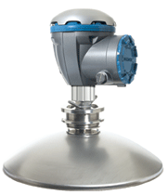
Digital Signal Integrity - Better Accuracy
Hardwired
Accuracy lost in signal conversations:
Digital to analog
Analog to digital
Accuracy lost in current calibration differences
Fieldbus
Measurements are not distorted
Particularly important:
Tank level gauging
Flow totalization and batching
Digital
Digital
AI
BUS
BUS
CTRL
CTRL
A/D
FF
Transmitter
FF
CPU
Transmitter
CPU
CPU
D/A
CPU
FF
FF
Digital
4-20 mA
Digital
Digital
Notes:
52
Measurements from digital sensors such as in pressure, level, and flow transmitters have very high accuracy, as good as 0.04%. The quantization error alone due to the digital-to-analog and analog-to-digital conversion required for 4-20 mA may be as large as 0.03% plus drift and differences in calibration in transmitter output and control system input make a significant contribution to the total probable error of the measurement. Such an error, for example, translates into a large volume for level measurement in a big storage tank. FOUNDATION fieldbus eliminates the analog domain to ensure integrity.

Slide 53
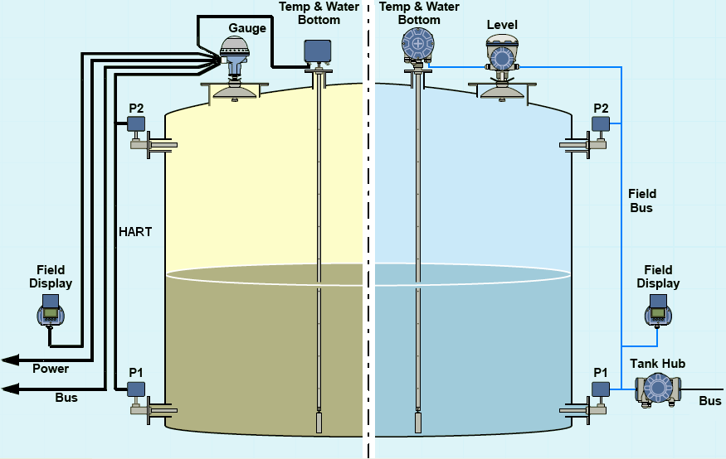
Two-Wire Intrinsically Safe Fieldbus Tank Gauging System: FMCW Radar
Hardwired
Fieldbus
Notes:
Frequency-Modulated Continuous-Wave
Rosemount Tank Gauging: Rex system (left), Raptor system (right)
www.rosemount-tg.com

Slide 54



Easier and Safer: Fieldbus Has High Signal Integrity
Hardwired
Analog gets distorted
Increased resistance limits current; power starvation
Water increases current
Dust
Humidity/condensation
“On-scale” distortion not detected; covert
Fieldbus
Digital signal does not get "limited"
Communication signal diagnostics
Any distortion of a digital process variable is alerted; overt
Increased resistance = Power starvation
Marshalling
AI
4-20 mA
Field Junction Box
Water = Conductor = More Current
Notes:
54
Many possible signal distortions that could occur on a 4-20 mA signal are difficult to detect and is likely to go undetected until manually tested. A change in process value due to loop current being limited due to increased loop resistance cannot normally be detected with analogue systems. Many conceivable faults on a 4-20 mA signal just turn one value into another valid value that gets accepted by the control system although wrong. FOUNDATION fieldbus eliminates the analog domain to ensure integrity.
Digital signal has only two states: 1 and 0. It is therefore less sensitive to distortion. Thanks to error detection, distortion can also be detected. An analog signal has infinite variation from 4 to 20 mA. Any value between 4 mA and 20 mA is valid, distortion can therefore not be detected.
Analog signals get distorted
If 20 mA becomes 18 mA you won't know: Increase in resistance due to terminal corrosion
If 16 mA becomes 18 mA you won't know: Increase in current due to housing water filling
Digital signal distortion does not go undetected
It is not possible to detect distortions in an analog signal

Slide 55
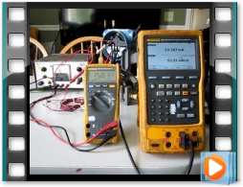
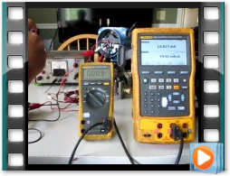
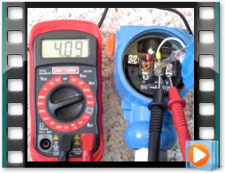
4-20 mA ‘On-Scale’ Faults
For insufficient compliance voltage increasing PV limits output (power starvation) but still appears valid (on-scale)
Increasing loop resistance starves transmitter limiting output but still appears valid (on-scale)
System cannot tell the signal is invalid as long as it is between 4 mA and 20 mA
Water in housing increases current but still appears valid (on-scale)
Notes:
Emerson Exchange 2014 Workshop “On-Scale Failures – What You Don’t Know Can Hurt You”
http://www.emersonprocessxperts.com/2014/11/digital-protocol-diagnostics-and-risk-analysis/

Slide 56
Easier and Safer - Full Sensor Limits
Hardwired
Limited low and high at the set analog 4-20 mA output range
Fieldbus
Utilizes sensor limits
Better understanding during abnormal conditions
Actual Process
Does not saturate at range
Saturates at 20 mA
Saturates at 4 mA
Utilizes full sensor limits
4 mA = 0 inH2O
20 mA = 150 inH2O
LSL = -250 inH2O
USL = 250 inH2O
Notes:
The entire loop is exactly as accurate as the sensor itself
Range Limit:
A transmitter is often able to measure well beyond the normal operating range for its application but values beyond the set range cannot be transmitted using the analog signal. This means that information that could be valuable during abnormal conditions is lost because the analog signal is saturated. Fieldbus transmit any value within the sensor limits and thus provides additional information when you need it the most. For example, as level goes above 10 ft, such as 13 ft, or 138 ft the analog world still shows 10 ft/100% - you don't know it is much more or how much more...

Slide 57
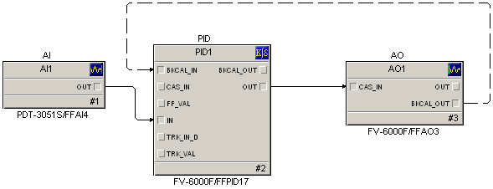
Operate With Confidence - Real-Time PV Validity Indication
Optional fault state Command
Validity:
Good/Bad/Uncertain
Limited: High/Low
Bumpless Transfer
Windup Protection
fault state Status
Designed for process control
Speed
25 times faster than hybrids of analog/digital
True 250 ms loops
Real-time value and status
Status Propagation (CIF & CIC)
Validated information
Quality and limits
Windup protection
Bumpless transfer for valves
Optional fault state for valves
etc.
Only fieldbus eliminates the analog signal
Notes:
A “digital” control system cannot rely on digital inputs and outputs
Transmitters are digital, controllers are digital, and valve positioners are digital so it does not make sense to have analog signals between them. A digital bus running at several kilobits per second enables a closed loop which is digital end-to-end, from sensor to valve. The communication is pure digital, deterministic, and real-time. In addition to digital signal integrity and real number value transmission, bus technology also provides signal validity indicating if value is good for control, uncertain, or bad. Thus automatic control action is not taken on invalid information. Standards-based interoperability enables control loops made up by devices from different manufacturers.
"non-safety-related process interlocks"
Point: The status associated with block inputs and output as well as the block status are utilized by DeltaV inspect to detect abnormal conditions
Status and value are always provided with block inputs and outputs.
The status from an input block tells you the Quality (Good, Uncertain, Bad) of a measurement and whether it is limited. Uncertain is used to indicate that a problem exists that may impact accuracy
The status associated with the BKCAL_IN on each control block indicates whether control is limited by a downstream block.
The PV status of the output block indicates if a problem is detected in a valve/actuator -uncertain if it still is working, bad if it has failed
By comparing actual and normal attributes of the mode parameter, you can determine if a block is being utilized as designed.

Slide 58
Real Time Status and Validity
Hardwired
Two functions, one signal:
Measurement value
Failure signal
Bad status flagged by masquerading as high or low PV
Process problems not distinguished from device problems
Fieldbus
Dedicated status signal
FF
Measurement Value
Quality (Bad/Uncertain/Good)
Limit (High/Low/Constant)
Sub-status (problems)
FF
Feedback Value
Quality (Bad/Uncertain/Good)
Limit (Open/Closed/Constant)
Sub-status (problems)
4-7 pieces of data in one link
Open Loop
Fault State Active
4-20 mA
Measurement Value / Failure Signal

Slide 59
Higher Availability: Distinguishing Device Problem from Process Problem
Hardwired
Device drives current <4 mA or >20 mA on device failure
Looks like process problem
PID counteracts thus tripping the loop
Operator cannot tell the difference between a process alarm and a device alarm
Fieldbus
Device health indicated by associated status
Good/Uncertain/Bad
Controller holds last position on device failure
Shutdown is optional
Operator can easily distinguish process problem from a device problem
No process trip on sensor failure
Burnout
Technical White Paper Available
Manual
(Hold Last)
20 mA
100%
0%
4 mA
Bad
AI
PID
AO
AI
PID
AO
Fail
Close
Fail
Alarm
Notes:
59
For an analog device you cannot tell the difference between a process alarm and a device alarm because an analog device drives current < 4 mA or > 20 mA

Slide 60
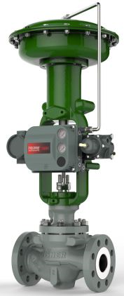
Even More Intelligent Valve and Positioner
Real-time valve position feedback on every valve transmission on the same two wires e.g. for historizing
No extra wire pairs
I/O count: No AI card
More than just value: status
“Virtual limit switches”
I/O count: No DI cards
No extra wire pairs
Easy to add feedback as an afterthought
Continuous performance diagnostics (“PD inside”) with alarm
Bumpless transfer on local hand operation
Smoother operation
Bumpless firmware update
Upgrade for feature enhancements while process is running, without replacing circuit board
Continuous, real-time, actual position feedback for every control valve – in faceplate and logic
Eliminate 1,000-2,000 I/O on a project with 1,000 valves
Notes:
The READBACK parameter in the AO block is the actual valve stem position so it shows the changing actual position as the valve travels whenever there is a change in flow characteristics. If the option “use PV for BKCAL_OUT” is selected, the BKCAL_OUT parameter will also reflect the actual valve position if needed.
Only in FF version: the diagnostics run continuously inside the positioner "PD inside" feature with NE107 alarms, while for HART the diagnostics is done on-demand from software using "PD one button sweep" feature.
Only in FF version: Actual position feedback on the same two wires
You get continuous actual position feedback for every control valve – in the analog days this was too expensive to implement for all but a few of the valves
Only FF: not just position value, but status for windup protection: when it has been hand operated and switching back to controller. The logic for the PID to use the feedback value and status is built into the FF blocks, no programming required – before standard FF blocks this would be very laborious to configure and test
http://www.controlglobal.com/articles/2014/refinery-expansion-runs-on-fieldbus/?show=all
“3. Bidirectional communications allow valves to report their position in real time.”
There is an emphasis on reporting position feedback in REAL TIME. That is, not only does there have to be feedback, but it also has to be fast, because valve movements are fast. If it is too slow, actual valve behavior will not be seen.
“With Foundation fieldbus, all valve positions are historized with valve position to support ad hoc troubleshooting of control loop performance. We believe that this alone is worth the price of admission.”
Emphasis on the importance of historizing valve position. Can see hunting and deviation (Air leakage, high packing friction, feedback issue). Actual position history is a good place to start troubleshooting when valve or positioner has a problem. Technician will look at the historical trending for anomaly just before failure. e.g. a valve may be hunting before it fails/experience passing.
“We corrected a number of valves with performance issues using the real-time valve position feedback capability of Foundation fieldbus positioners. We found that a quick loop check doesn't always uncover all valve problems, as the loop check team doesn't have the time to watch a valve for many minutes. Post-loop check, we would set a valve somewhere between 25 and 75% to see if it would have tracking problems. Figure 5 shows an example of the kinds of problems we would find. This particular valve did pass a loop check (the quick steps in the center of the trend). It was within range of being on target so the field team passed the valve. However, as you can see, when left alone, the valve started misbehaving.”
Stressing REAL-TIME valve position feedback and the ability to see if the valve is tracking (actual position is able to track the setpoint)

Slide 61
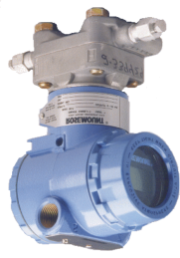
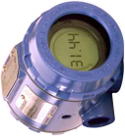
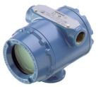
Reduce Measurement Errors - Eyelevel Indication without Impulse Lines
Old Way
Impulse line
Prone to plugging
Fieldbus Way
Direct coupling
Easy to install later
Easy to add variables
Pipe Rack
Virtual Signal Conditioner
Signal calculator
Min/max selector
Signal limiting
Signal switching
Lookup table
Etc.
“Virtual Impulse Lines”
Impulse line
Fieldbus network (peer-to-peer communication)
Eyelevel
Multi-point Fieldbus Field Display
Notes:
If transmitter is mounted high up, use field display to make display visible
Can compute values based on multiple inputs. For example average temperature, compensated level, compensated flow
If transmitter is mounted below deck/flooring, use field display to make display visible
4-20 mA has series loop-powered LCD field field display, but often, as in the case of Exia, the voltage is too low to drive both transmitter and field indicator.
This is only possible with FF, not Profibus, because FF is peer-to-peer communication so indicator can receive value from transmitter

Slide 62
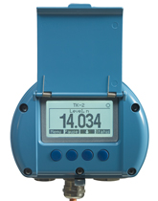





Platform for the Future
Fieldbus multi-channel two-wire temperature transmitter
8 channel, universal input
Multi-variable Fieldbus Indicator
8-point
Without fieldbus you cannot benefit from new innovations
Intelligent two-wire intrinsically safe Fieldbus inventory tank gauging system FMCW radar
Intelligent two-wire Fieldbus On-Off valve
Dual Fieldbus Temperature Transmitter
- 2 channels can be used for control
Notes:
Frequency-Modulated Continuous-Wave
It is hard to imagine exactly what marvelous innovations and possibilities the future will bring, but you need Foundation fieldbus digital platform to be able to access these opportunities. Analog are incapable of directly supporting more than one simple process variable per device. This limits future instrument possibilities such as multi-parameter sensors, hearing (sound bites), and vision (video clip) in remote applications. Devices already available include field mounted temperature transmitters with as many as eight inputs.
high-density multi-point temperature transmitters are examples of devices that use Foundation H1 to reduce cost and simplify installation.

Slide 63


Virtual Flow Computer
Built-in mass flow compensation
Pressure and temperature received over fieldbus
Displayed locally
Standard transmitter hardware; firmware options
Pressure
Mass
Flow
DP
Temperature
Notes:
The mass flow compensation option only available in FF version of 3051S.

Slide 64
Reduce Measurement Errors - Virtual Remote Seals
Hardwired
Delicate
Capillaries
Temperature effect
Slow
Virtual Remote Seal
Technical White Paper Available
Fieldbus
Robust
Cable
Accurate
Fast
`
`
Field Junction Box
Field Junction Box
`
`

Slide 65
Four Options to Do Closed Loop Digital Control
Control in Controller (CIC)
Traditional way
Control in the Field (CIF)
Single loop integrity when used in conjunction with backup LAS
Less communication
Synchronized: single cycle
Devices must be on the same bus
Operator can't see the difference
80/20 CIF/CIC
Controller
Transmitter
PID
Valve
H1 Card
AI
Transmitter
AO
Valve
AI
PID
Valve
AO
Transmitter
AI
PID
AO
Controller
CIF
Technical White Paper Available
Transmitter
H1 Card
Valve
AI
PID
AO
Notes:
Function Block Diagram Language
More than a communication protocol, FOUNDATION fieldbus technology includes a visual function block programming language for building control strategies per IEC 61804-2. This includes standard blocks for input, control, arithmetic, selection, alarms, and output etc. as well as links between blocks in the same or different devices or the system. Links include status information such as validity, limit condition for windup protection, fault state, and bumpless transfer etc.. The execution of the function blocks in the devices, and some systems, is synchronized with the communication as per a schedule. The real-time clock enables the device to execute blocks at precisely the right moment in each cycle for optimum performance of sampling-time dependent functions such as PID, damping, lead-lag, and integration (totalizers) etc. FOUNDATION fieldbus was designed for process control.
80% basic control loops can be done in the field.
Foundation H1 completely eliminates the analog domain, permitting a totally digital control loop where signal integrity is preserved end-to-end.
Foundation H1 permits control in a central controller of DCS but optionally enables basic control to be executed in field devices such as a valve positioner. For simple PID loops, control in the field may result in faster loop execution. Another benefit of control in the field in conjunction with backup LAS, is single loop integrity: control can continue without controller or interface card as long as power is available to the bus. It is not uncommon for plants to use both control in the field for basic loops and central control for sophisticated loops including interlocks and permissives etc.

Slide 66
Time Synchronized Digital Closed Loop Control
Hardwired (and other buses)
"Free running"
Longer time
Jitter = sampling period not constant
FOUNDATION fieldbus
Time synchronized
Scheduled
Precisely periodic (isochronous)
e = PV-SP
dt = sampling period must be constant
Designed for process control
Notes:
For optimum control loop performance the transmitter shall first measure, transmit the measured value, then the controller control, transmit the desired valve position, and lastly the positioner moves the valve. In that order, every cycle. Other bus technologies cannot make this happen. A unique feature of FOUNDATION fieldbus is that devices and systems operate according to a common schedule ensuring function blocks are executed and real-time data communicated in the right order at exactly the right time on a precisely periodic basis. That is, control strategy and communication are synchronized from transmitter to valve for optimum PID control. FOUNDATION fieldbus was designed for process control. True control periods of 250 ms can be achieved. The schedule is automatically configured by the system.

Slide 67


Easy: Scheduling is Automatic
Schedule is automatically created
Notes:
Macrocycle viewer in the DeltaV system was enhanced to display macrocycles with multiple “schedules”.
67

Slide 68
End-to-End, Fieldbus Control is Faster - True 250 ms
Hardwired Control
AI scan, controller, and AO scan not synchronized
Fieldbus Control
AI scan, controller, and AO scan synchronized
True 250 ms
Single cycle
250 ms
Digital Control
Technical White Paper Available
True 250 ms
Controller
AI
AI
AO
AO
AI
PID
AO
Add Multiple IO and Control Cycle
Notes:
The CPUs in the AI card, controller card, and AO cards are not synchronized. Therefore passing of data from one card to the next may miss a cycle carrying over to the next cycle. This makes the total end-to-end response time long. That is, a 250 ms controller cycle does not mean a 250 ms control response period.
Fieldbus is synchronized, so for Control-in-the-Field (CIF), a 250 ms macrocycle means a true 250 ms control response period

Slide 69


Time-Synchronized Digital Closed Loop Control
Digital end-to-end
Transmitter, controller, and valve are time-synchronized for better response
For pressure and flow FF loops performs 10-15% better than a loop using 4-20 mA signals
http://www.youtube.com/watch?v=oiCUYCPPP2I
Notes:
Video: Understanding the User Case for CIF
http://www.youtube.com/watch?v=oiCUYCPPP2I
0:00 Dr. Andy Clegg from Industrial Systems and Control in Glasgow
0:30 Spin-out company out of Strathclyde University
3:30 The results produced from this analysis is predominantly showing it is only on the very very fast loops where the performance of control in the field is very significant, and on those slower loops there is negligible performance benefit between 4-20 mA and control in the field
5:00 Benefits of the very highly deterministic nature of control in the field really came into its for, on the very fast process control loops like pressure and flow. So if you've got pressure and flow loops the performance there probably improved by we were predicting between 10-15% performance benefit over a 4-20 mA loop.
(slide 1)
5:25 Now obviously as loops got slower, that performance benefit decreased quite quickly. Such that anything above around a loop that was say with a 50 second or a 1 minute settling time the performance benefits there were getting marginal.
(slide 2)
(slide 3)
5:45 So it is really focusing on the fast loops, and also importantly, it's also affected by the dynamics of the disturbances that the control loop is trying to control against. So if you have disturbances which are very fast, either step changes or random walk type effects, they benefit the most. Whereas if you've got slowly varying disturbance like ambient temperature which is very slow, but any sort of slowly varying disturbance, there isn't going to be any performance benefit there as you would expect.
6:30 There are a lot more benefits to using control in the field than just the simple determinism, but were just looking at the control loop performance i.e. how much the variability reduced by control in the field.

Slide 70




Reduced Process Variability Improves Quality and Reduces Cost
Quality &
Throughput Improved!
Notes:
THIS IS A BUILD SLIDE
So, you can now start to see how predictive intelligence can help you find that perfect plant and deliver the significant results we are talking about…because today all the 1000’s of anomalies go unseen (we just went through 3 quick examples). Today, (CLICK) process variation IS NORMAL and we’ve accepted this as normal because we never had the software before to detect and correct. And this variation builds and propagates through the process…and into the product. But (CLICK) you can find these (or rather they will find you!) and eliminate them and the result is really significant in terms of improved process control, better quality, increased throughput, a more robust base on which to run APC, even the ability to do what we call target shifting which would allow you to move your operating limit. All possible.
BACKGROUND:
Target Shifting…say for example that the minimum acceptable quality level for a given parameter is just at the left end of the blue bell curve. In order not to go below this level, we would set our setpoint for this quality parameter at the middle of the blue bell curve (it’s actually quite a ways above our target, but we have to do that in order to insure that we’ll never go below it because we’ve got big, fat, sloppy variability in our process). Now, if we are able to get our variability under control to the green bell curve, we can actually MOVE OUR SETPOINT about 60% closer to our target…think of the savings opportunities for raw materials, energy, catalyst, etc that goes into making this product.

Slide 71
Fieldbus Maintenance Benefits

Slide 72
Main Areas of Fieldbus Maintenance Benefits
Better maintenance and turnaround planning
More powerful diagnostics in two-wire devices
Intelligent discrete devices like on-off valves
Easy to add instruments for equipment condition and performance monitoring; on-premises or IIoT
Easier daily maintenance
No I/O cards to maintain in the field
Centralized firmware update for devices to enjoy feature enhancements
Notes:
If the intention is to go through all detail slides, then quickly gloss over this slide just saying there are 4-5 major areas of project benefits
More current for more powerful two-wire loop powered devices with more diagnostics for better maintenance and turnaround planning
Intelligence everywhere: intelligent discrete devices like two-wire on-off valves
Balanced (non-grounded) signal with high amplitude for noise immunity
Centralized firmware update for devices to enjoy feature enhancements
There are no I/O cards to maintain in the field.
Easy to add instruments for equipment condition and performance monitoring to existing networks; on-premises or IIoT

Slide 73
Easier Device Replacement - No Range Mismatch
Hardwired
Possible range mismatch
Requires 5-point loop test
Fieldbus
Real number engineering unit value
Unit downloaded when device is replaced
Reading
61.728kPa
...alarms and trips
not working
Range
0-400 kPa
Range
0-400 kPa
AI
CTRL
AI
CTRL
Range
0-800 kPa
A/D
CPU
FF
CPU
Transmitter
Transmitter
D/A
6.47 mA
FF
123.456
CPU
CPU
Process: 123.456 kPa
Process: 123.456 kPa
Notes:
73
The entire loop is exactly as accurate as the sensor itself
Range Mismatch:
For a 4-20 mA transmitter it is necessary to set a range, meaning the process values corresponding to 4 mA and 20 mA. If there is a mismatch in the range between the transmitter and the controller, control and alarms will not work with potentially serious consequences. For fieldbus the values are transmitted in engineering unit avoiding range mismatch.
For 4-20 mA there is no widely accepted way of indicating that the transmitter range has been exceeded. When the signal saturates at 20 mA in the transmitter, controller, or an intermediate converter, there is no way of knowing if the value is indeed 100% or something else. Although a clever workaround exists, it is not widely implemented in devices. For fieldbus there is a status that flags if the value is limited low or high advising it may not be the true value.
Range Limit:
A transmitter is often able to measure well beyond the normal operating range for its application but values beyond the set range cannot be transmitted using the analog signal. This means that information that could be valuable during abnormal conditions is lost because the analog signal is saturated. Fieldbus transmit any value within the sensor limits and thus provides additional information when you need it the most. For example, as level goes above 10 ft, such as 13 ft, or 138 ft the analog world still shows 10 ft/100% - you don't know it is much more or how much more...

Slide 74
Intelligent Two-Wire On-Off Valves - Fieldbus Does Discrete Too
Hardwired
Three pairs of wires per On-Off valve
Three I/O channels per On-Off valve
HART not applicable to On-Off devices
Problems finding safety barrier compatible with solenoids
FOUNDATION fieldbus
One pair of wires for multiple On-Off valves
One pair of wires for solenoid and limit switches
Shares FF barrier with other devices
Diagnostics
Fieldbus
Discrete
Technical White Paper Available
Notes:
Solenoids are very different, turn-on and turn-off voltages, and operating current draw, and entity parameters are all different. Finding a suitable model safety barrier is very time consuming.
Note that this presentation is only concerned with On-Off valves connected to a Basic Process Control System (BPCS) such as a DCS, not Emergency Shutdown (ESD) valves connected to a logic solver part of a Safety Instrumented System (SIS). Process automation applications for On-Off valves include filling and emptying of tanks, backwash and blow-back of filters, loading and unloading, sequencing of equipment in batch applications etc.

Slide 75




All Devices Digitally Integrated; - Predictive Maintenance for All
Fieldbus
Traditional Smart Devices
On-Off
Valves
MOV
“Complex” devices (many signals)
Many more devices around the plant can benefit from device management: diagnostics
No device left as an "isolated island"
Notes:
HART is only used in transmitters and positioners. HART does not help in the management of On-Off valves and electric actuators etc.
FF is supported in many other kinds of devices too
In addition to simple and multi-variable devices, bus technology simplifies integration of complex devices requiring multiple signals for operation or produces several readings. This includes electric actuators, and variable speed drives as well as discrete devices such as On-Off valve actuators and motor starters - device types not supported by earlier smart protocols. In the past, each complex device required multiple wires. With bus technology, a single pair supports multiple devices resulting in drastic cost reduction. New innovative devices such as field displays are made possible.

Slide 76
Device Diagnostics is Important
Field device failures cause production losses much more than controller/system failures
Therefore field device diagnostics is very important
Controller 8%
Diagnostics
Technical White Paper Available
Measurement 42%
Final Element 50%
Causes of Production Losses
Sources:
Marsh & McLennan Protection Consultants
HPI Market Data 2003,Gulf Publishing Company
Notes:
Field devices account for a much larger portion of loop failures than the control system itself because field devices operate in harsh ambient conditions and are in contact with the process. A device failure will typically affect the process within minutes or hours.
Predictive self-diagnostics in Fieldbus devices is used to spot impending problems and schedule inspection and maintenance before the process is affected. For example, the temperature transmitter detects thinning of thermocouple wire and alerts technicians in advanced before the sensor fails thus preventing unscheduled shutdown. The valve positioner monitors valve health and alerts the maintenance technician before the valve fails.

Slide 77

Reduce Maintenance Cost
“Unneeded” Trips To The Field - Avoided Through Remote Diagnostics
63%
Diagnostics
Technical White Paper Available
Routine
Check
No
Problem
Calibration
Shift
Zero
Off
Plugged
Lines
Failed
Instrument
Source: Dow Chemical Company
Notes:
THIS IS A BUILD SLIDE
We just touched on how predictive intelligence can impact one aspect of the output of our plant, and also the cost of production with target shifting. Another significant cost reduction and productivity enhancement opportunity is in the area of Maintenance. The results from Fieldbus customers show that they have consistently seen cost reductions of 40%. This workorder analysis from Dow Chemical show why.
In a typical plant (CLICK) 63% of the Maintenance workorders resulted in NO VALUE ADDED WORK! That’s ghost chasing and going out to the field and checking things that were working.
With Fieldbus, this work is virtually eliminated. And…when you need to do it, you can make that check by calling up the device through the CRT and seeing a MUCH MORE complete picture than by going to the field and looking at a piece of equipment shrouded in metal! NOTE: There are many plants in Western Europe and North American that may feel like they have already cut their maintenance staffs back almost below the point of being able to safely maintain their plant, so…they may ask, where is the saving? The opportunity for them is in productivity improvement (67% improvement in maintenance productivity) so their people can focus on value added work, and start moving their plant from reactive to predictive and proactive and focus on issues that cost the plant unplanned downtime and deliver cost savings in other areas.
But don’t take it from us…the real proof comes from others who have done it

Slide 78

Easier and Safer: Central Diagnostics for Troubleshooting
Verify device problems are real before going to the field; or unmanned platform
Device tells technician when there is a fault or performance is degraded
Plan when to repair:
Immediate
Daily schedule
Next turnaround
Notes:
save on trips to unmanned platforms

Slide 79

Easier: More and Faster Diagnostics Alarms
Model | Type | Diagnostic Differences
3051C | Pressure transmitter | Plugged Impulse Line Detected
 |  | Process Anomaly Detected (SPM)
 |  | Sensor temperature
3144P | Temperature transmitter | Thermocouple Degradation
 |  | Min/Max Temperature Tracking
 |  | Process Anomaly Detected (SPM)
644 | Temperature transmitter | Sensor/electronics temperature
8800 | Vortex flow transmitter | Sensor/electronics temperature
8700 | Magnetic flow transmitter | Electrode Signal Fault
5400 | Radar level transmitter | Sensor/electronics temperature
DVC6000f | Valve positioner | Continuous performance diagnostic; “PD inside“
 |  | Temperature High
 |  | Temperature Low
Diagnostics for discrete too
More power for sensors and greater processor power
Faster detection and reporting
Time-stamped
Diagnostics
Technical White Paper Available
Notes:
Performance diagnostics run continuously inside FF positioner "PD inside" feature with NE107 alarms, and for 4-20 mA/HART positioner the diagnostics is done on-demand from software using "PD one button sweep" feature.
FOUNDATION fieldbus technology has completely eliminated 4-20 mA and are therefore not limited to operate on 4 mA. These devices have 10 mA or more to operate on and therefore can run the diagnostics and statistical process monitoring much faster and may even have auxiliary sensors for additional diagnostics. FOUNDATION fieldbus eliminates the 4 mA current limitations and can use this "extra" power to provide faster and more intensive self-diagnostics. Fieldbus devices also use the additional power to provide better isolation and noise suppression for more robust measurements.

Slide 80

Get Visibility Where There Was None Before
Intelligent On-Off valves with predictive diagnostics
Loss of supply air
Valve jammed
Etc.
Diagnostics
Opening time
Close time
Cycle count
High temperature
Low temperature

Slide 81











Easier Central Device Firmware Update
Designed for process control
Upgrade field devices for feature enhancments online without changing circuit board
Dual memory bank bumpless upgrade of valve positioner
Update firmware while process is running
Notes:
Fieldbus devices communicate fast enough to accept firmware update from the system enabling them to easily be bumplessly upgraded online to take advantage of features in new versions staving off obsolescence.

Slide 82

FOUNDATION Fieldbus for IIoT - Build on the Fieldbus You’ve Got
Add instruments for equipment condition and performance monitoring
On premises or IIoT
Fieldbuses usually not fully populated
Add sensors for energy management
M
2
Control System
Condition Monitoring System & Energy Management System etc.
S
Process Control & Monitoring
Condition Monitoring & Energy Management etc.
Notes:
The plant may already be using fieldbus for process control. Sensors can be added to these fieldbus networks for condition monitoring and energy management in preparation for IIoT.

Slide 83
Making Fieldbus Easy to Deploy
Notes:
Fieldbus is no longer new and experimental. Fieldbus was very difficult the first couple of years because the products and software were not very good and the test tools did not exist. Emerson has over the past ten years made fieldbus easy to use based on feedback from thousands of fieldbus users. The Fieldbus Foundation has improved the technology and instituted rigorous testing. Many third parties have developed specialized fieldbus test tools. However, most other control systems have not done their homework.

Slide 84




Integral Fieldbus Power
No separate Fieldbus power supply required
Trunk lands directly on H1 card
No marshalling cabinet
H1 and power redundancy
Fewer cabinets: smaller footprint, weight, power
Simplified engineering
Power
‘96 Channel I/O Card’
2 ports
16 devices per port
3 signals per device (average)
Interface
Notes:
?

Slide 85
Eliminate Marshalling Cabinet
1st Generation Fieldbus
Separate fieldbus power supply
Modern Fieldbus
Integral fieldbus power supply
No marshalling cabinet
Trunk lands on H1 card
FPS
FPS
P
P
FPS
FPS
JB
T
JB
T
FPS
FPS
CONTROLLERS
MARSHALLING
JB
CONTROLLERS
JB
& INTERFACES
& POWER
& INTERFACES
WITH POWER

Slide 86

4-Port Fieldbus Interface Card
4 ports
Up to 16 devices per port; total 64 devices
Multiple I/O signals per device
Redundancy
Use with traditional fieldbus power supplies
‘128 Channel I/O Card’
4 ports
16 devices per port
2 signals per device (average)

Slide 87

System Interoperability - Host Profile Registration (HPR): 61b
HPR
61b
Test process ensures Fieldbus is implemented correctly
Device commissioning
Function block configuration
EDDL
NE107 device diagnostic alarm management
Status handling
Profile: ’61’
Compliance Level: ‘b’
Notes:
HPR takes the place of the old Host Integration Support Test (HIST)

Slide 88

Easy Engineering Control Strategy Configuration
CIF
Technical White Paper Available
IEC 61804-2 function block programming language
Central or field control from the same software
Mode and status propagation works the same in central controller and field devices
Same parameter names
Universal control strategy templates
Notes:
40
In the DeltaV control system, the same configuration software and the same type of function blocks are used to build control strategies for loops with Fieldbus I/O as for conventional I/O, and for Control-In-the-Field as for Control-In-the-Controller. Conventional, Fieldbus, or other bus I/O can be mixed in the same loop. There are no additional steps for Fieldbus or for CIF.
The function block and communication schedule for Foundation fieldbus is created automatically and is downloaded to Fieldbus devices along with the rest of the configuration such as blocks and links. The bus macrocycle can be selected short or long depending on the loop control response period requirements. It is even possible to mix fast and slow loops on the same bus.

Slide 89

Easy and Fast Engineering: - Virtual Fieldbus “Test Panel” for Full FAT
No need to connect lots of devices
Emulate
FF modules
Fieldbus devices
Function blocks
Test
Control loops
Graphics
Faceplates
Scale/range, units, transfer function, channel, fault state
Alarming
Very fast
Notes:
Digital Bus Process Simulation
mimic is the only process simulation software available that supports digital busses. Specifically, the mimic digital
bus interface performs the following functions:
♦ Simulates DeltaV interface modules for Foundation Fieldbus H1, AS-i Bus, ProfibusDP and DeviceNet.
♦ Simulates field devices in DeltaV Explorer and Diagnostics for the above listed DeltaV interface
modules.
♦ Simulates the operation and processing of the following Foundation Fieldbus function blocks: AI, AO, DI,
DO, MDI, MDO, MAI, PID, ISEL, INT, and ARTH.
♦ Simulates process alarming from the above listed Foundation Fieldbus function blocks.
♦ Does not simulate the operation of Foundation Fieldbus resource or transmitter blocks
♦ Does not simulate any device specific alarms on digital field devices.
♦ Requires the use of the DeltaV Railbus Pack and DeltaV Wats Interface card or DeltaV Virtual IO
Module.

Slide 90



Function Block Assignment to FF H1 Interface Card
Time-synchronized like control in the field (CIF)
Fast block execution
Large block library
CIF
Technical White Paper Available
Notes:
9.3

Slide 91





Easier FF Device Commissioning (and Replacement)
DeltaV v10.3
Commission (or replace) device without touching the software
System automatically logs process in background
Automatic configuration reconciliation with device database
Automatic configuration download
View details in historian and log
Notes:
₉₁
A new capability in the DeltaV and AMS Device Manager systems automates the commissioning of FF devices. As long as there is a tag match and device revision match between the database and the device being commissioned, the system can perform the necessary tasks without the need for human interaction.
Based on user preference (one for automatic commissioning and one for automatic replacement), the system is able to automatically reconcile any Resource/Transducer block parameter differences between the AMS Device Manager database and the field device.
Operators and/or maintenance technicians can follow the progress of the automatic commissioning task in a newly developed progress log accessed via the DeltaV Diagnostics application. A log file is also created and stored as a more permanent record of the events.
Latest version of DD from the Fieldbus Foundation lets the device manufacturer tell which earlier versions of a device type the file is compatible with – thus allowing direct replacement not only with the exact same version, but also with some other versions as well. That is, the technician need not search the store for the exact same version.
Operators and/or maintenance technicians can follow the progress of the automatic replacement task in a newly developed progress log accessed via the DeltaV Diagnostics application. A log file is also created and stored as a more permanent record of the events.
The Automatic Fieldbus Device Replacement/Commissioning feature in the DeltaV and AMS Device Manager systems automates the reconciliation of Resource and Transducer block information between the AMS Device Manager system and the device during replacement or commissioning. The behavior of the reconciliation is determined by settings in the DeltaV system that allow the user to specify whether the device or database contains the master configuration set (there is one setting for dictating the behavior of automatic device commissioning and one setting for automatic device replacement).
Once the replacement device is successfully commissioned and reconciled by the system, the device is downloaded so that it can be placed into service.
In addition to the progress monitor in the DeltaV Diagnostics application, a log file is also created and stored as a more permanent record of the commissioning/replacement events.
With Easier Device Commissioning and Replacement, as long as there is a tag match and device revision match between the database and the device being commissioned / replaced, DeltaV and AMS Device Manager can perform the necessary tasks without the need for human interaction.

Slide 92




Fieldbus Maintenance Made Easy: Guided Device Commissioning Wizard
Automatic address assignment
Verifies correct device type
Notes:
The DeltaV system has a special wizard that takes the technician step-by-step through the process of commissioning a Fieldbus device, including automatic address assignment to avoid human errors like address duplication etc. The guided procedure continues with comparison and reconciliation of the configuration in the device and system database, and lastly the configuration download. The device commissioning wizard takes the mystery out of Fieldbus device commissioning.

Slide 93

Standardize Device Configuration - Device Templates
Create once, use for many devices
Start from scratch or live device
Eliminate download errors and non-functional devices
Reuse device templates on future projects
Notes:
A well-defined template has meaningful values for all parameters, allowing smooth commissioning with no error messages or device malfunctioning due to configuration problems.

Slide 94

Device Factory Setting Upload
Upload and save working device factory configuration into database (range and unit etc.)
Ensuring it is not overwritten at download
Notes:
Can upload I/O function blocks only, not control blocks
One device at a time on demand.
DeltaV does not touch transducer blocks

Slide 95


Fieldbus Maintenance Made Easy: Protective Decommission
Removing device in an orderly fashion
“Safely remove hardware”
Temporary removal
To remove for bench calibration etc. with intention to put back into same place soon after
Permanent removal
To remove for replacement etc.
Control-in-the-field does not mean just “simple” PID
Notes:
Just like “safely remove hardware” in Windows
Temporary removal
To remove for bench calibration etc. with intention to put back into same place soon after
Decommission to Offline
Tag remains
A convenience feature so device is easier to put back into operation
Permanent removal
To remove for replacement etc.
Decommission to Spare
Tag is cleared
A safety feature making sure the device does not cause conflicts when connected to another bus in the future
So the way it works is that "make spare" deletes the tag (putting device ID as tag) while "make offline" retains the tag so easy to see which place holder to drag-and-drop it to and there is no database reconcile step
The “Do Not Wait” simply hides that dialogue box. It still takes time for this process to happen in the background
Spare: Tag = DeviceID, Address = 248-251
Offline: Tag = retained, Address 248-251
Standby: Tag = retained, Address 232-247
Commission: Set Tag, Address 20-35
So presumably Invalid is address 36-231

Slide 96

Keeping System Up To Date - Add Device Wizard
Load DD files in one single place
Automatically updates entire system
Automatically puts DD files into the correct folders
DD for all devices loaded
Ready for use if device comes into plant
Notes:
The DeltaV Explorer Add Device Type Wizard makes adding support for new device types and versions easy by loading the support files on the DeltaV ProPlus station they are automatically copied to all station in the system. There is no need to install DTMs or other software each machine. No license key management. No Windows conflicts. Device support files for new device types can easily be downloaded from the Emerson website.

Slide 97





Guardian Automatic System Update - DD Update Manager
DeltaV v12
DeltaV and AMS Device Manager automatically download new DD files from the Guardian server in the cloud
The system is automatically kept up to date, ready for new device types and versions as they come to the plant
No need to search for files
Upgrade to DeltaV/AMS v12
Manual File
Transfer or
Network
Connection
Notes:
Device Description Update Manager (DD-UM) and Guardian

Slide 98

Automatic System Update
The system is automatically kept up to date, ready for new device types and versions as they come to the plant
No need to search for files
Notes:
DD-UM

Slide 99
Easy to Run & Maintain - Single Device Integration Technology
Only need the DD files
Don’t need to worry about DTMs programs
System is shipped with DD for all devices in the market loaded whether used on the project or not
Chances of support for devices missing is low
Could not be done with DTM
DD file for all FF devices available from the FF site
Can’t find DTMs there
Easy to copy the DD files onto the system
DTMs have to be installed
Notes:
DeltaV does NOT need FDT/DTM. This means you only need the DD files, you don’t need to worry about DTMs programs. Therefore DeltaV is shipped with DD for all devices in the market loaded (whether used on the project or not) on the system (you can’t install all DTMs) so chances of support for devices missing is low. Secondly, if any device support is missing, you can simply get the DD file from the FF site (you can’t find DTMs there) and you only need to copy the DD files onto the system (DTMs have to be installed). That is, DeltaV is easier because it uses a single technology instead of two.

Slide 100

Faster Project Startup Express and Bulk Download
DeltaV v10.3
Reduced commissioning time
Initiate multiple downloads at the same time
Runs unattended
At pre-commissioning need not run as a background communication to real-time control
Notes:
₁₀₀
This new option for FF device/segment downloads speeds up commissioning activities.
A dialog will show all (and only) the FF devices and segments in a DeltaV system. The dialog will allow concurrent selection of multiple segments and FF devices for download.
This project will reduce commissioning time for FF projects
Express download suspends the precisely periodic control macrocycle (so cannot be done on a running plant) but becomes 50% faster when used at commissioning before startup
You can select several networks and go home... DeltaV will handle all the download unattended. No questions/prompts asked, all accepted. Any errors are logged.

Slide 101



Faster Commissioning: - Skid/Package Import
DeltaV v10.3
Optionally retain the commissioning state of FF devices upon import of configuration
Eliminates the need to commission FF devices at both the skid vendor’s location and the final installation
Notes:
₁₀₁
Reduces the need to perform Ff device commissioning activities twice when the DeltaV project is performed in pieces. For example, if a process skid is outfitted with Ff devices, it is likely desirable to commission and check out the devices and operation of the skid at the skid vendor’s facility. In many cases, project teams perform the device and system checkout using a standalone DeltaV system, and then merge the configuration into the main DeltaV configuration database before plant startup. In previous versions of DeltaV, the commissioning state of the devices would be lost when the small system’s configuration was imported into the main DeltaV system. Now, for v10.3, the user will be able to optionally retain the commissioning state of Ff devices contained in the import file. The option is displayed as a checkbox on the import dialog.

Slide 102
Making Fieldbus Easy to Run and Maintain
Notes:
Fieldbus is no longer new and experimental. Fieldbus was very difficult the first couple of years because the products and software were not very good and the test tools did not exist. Emerson has over the past ten years made fieldbus easy to use based on feedback from thousands of fieldbus users. The Fieldbus Foundation has improved the technology and instituted rigorous testing. Many third parties have developed specialized fieldbus test tools. However, most other control systems have not done their homework.

Slide 103


Fieldbus Faceplates and Detail Pages
Full FF support
Mode
Status
Alarms
Actual position feedback
Notes:
DeltaV faceplates are not limited to the same information as hardwired devices and loops. DeltaV Operate has standard device alarm faceplate, loop faceplate, and detail page created specifically to take full advantage of Fieldbus features.
The Device Alarm Faceplate is accessed from the alarm banner in a single click and makes full use of the Fieldbus alarm indication. The intelligent device management software is accessed directly in a second click. The faceplates for CIC and CIF loops are the same.
The Loop Faceplate displays full Fieldbus status, provides full support for fieldbus mode, and makes full use of fieldbus alarm indication
The Loop Detail Page provides full access to Fieldbus limits and alarms levels as well as tuning, makes full use of alarm indication, and displays full Fieldbus status and errors.

Slide 104

Easy Operation - PID Auto Tuning for CIF
On-demand or adaptive tuning of PID
In DeltaV controller
In Emerson fieldbus devices
Recommends tuning based on test
Loop remains under control during test
Control-in-the-field does not mean just “simple” PID
CIF
Technical White Paper Available
Notes:
DeltaV InSight's On-Demand Tuning is available
for PID and Fuzzy Logic control blocks in the DeltaV
controller or Emerson FOUNDATION fieldbus devices.
Tuning recommendations are available on demand
by initiating automatic testing of the process. During
the tests, the loop remains under control to prevent
large disturbances to the process. The on-demand
tuning is based on the patented Åström-
Hägglund algorithm referred to as relayoscillation. Users may easily adjust the
desired speed of response for the control loop to
speed up or slow down the closed loop response.
Advanced users may also specify optional tuning
rules for modified Ziegler-Nichols, Lambda, or
Internal Model Control.

Slide 105

Easy Operation - Status in Historian
Status logged and shown next to value and color codes trend
Notes:
The status associated with the process variables and other values is very valuable in validating data and for troubleshooting. The DeltaV historian collects status as an integral part with the value without additional configuration work and without increasing the historian tag count. The status is indicated as text adjacent to value and time-stamp and as a different color in trends. Status is also included in generated reports. That is, this highly valuable feature of Fieldbus is not lost in historical records.

Slide 106








Availability: Operator Receives Critical Diagnostics Alarms
Device tells the operator
Only critical problems that affect the operator’s process
NAMUR NE107
FF
Notes:
Process alarm detection can be done inside FOUNDATION fieldbus devices. Diagnostics is also communicated as alarms. Devices notify events such as parameter changes. Collectively, alarms and events are called alerts, communicated up to the system and included in system log. Notification is by exception, that is only when state changes. This is the most efficient use of communication. Device field diagnostics is prioritized and categorized as per NAMUR NE107 recommendation, such that the system can bring it to the right person, without flooding others in alarms. The real-time clock in the device is used to time-stamp the alerts in the device. The sequence of event recording is therefore accurate even if communication is not instantaneous.

Slide 107



Smart Diagnostics - Integrated Device Diagnostics
Normal operation...
Critical device failure...
Alarm Faceplate...
Diagnostics
No device configuration by operator
Displayed the way the device vendor intended
Faceplate
Detail
Help
Detailed diagnostics in two clicks
Help on the third

Slide 108
Real-Time Decisions - Integrated Device Diagnostics
Engineering station
System configuration
FF device commissioning
Device configuration
Operator station
Process operation
Process alarms
Critical device failure diagnostics
Maintenance station
Device management
Process visibility
Plus:
Device Configuration
Traditional Architecture
Plus:
Device Diagnostics
Plus:
Process visibility
Engineering
Operator
Operator
Operator
Maintenance
Notes:
DeltaV with AMS Device Manager meet the suggestion from NAMUR NE91 for an integrated host solution. Because EDDL is text-based it is not interfering with the control system. Therefore the control system engineering station can also configure the device. That is, complete configuration from a single station. This makes it easy to verify range in system and device is the same. Device diagnostics can be displayed in the operator console. This has the advantage that when critical device failures occur (operators are not burdened with non-critical advisory alerts), they have a few minutes or hours to take action before it develops into a process problem. An important observation here is that the operator workstations are always manned so device alarms are noticed, while maintenance stations usually are not so device failures go unnoticed. The maintenance station has process visibility allowing technicians to check vessels are empty and pipes depressurized before device is removed.

Slide 109

NE107: Critical Device Alarms to the Operators
NE107 prevent alarm flooding
Notes:
Also, different users have different information needs depending upon their roll.
For example, engineering works on process problems.
Rationalized real-time process alarms, critical early warning alerts, and degraded safety performance alerts help operators to run the plant safely.
Plant maintenance cares about equipment health and performance to support operational goals.
Safety professionals and safety experts focus on degraded safety performance information.
Operations – critical early warning, control strategy system
Maint – device alerts planned
Safety- safety issue tripped
Eng – process or production impacts

Slide 110
Making Fieldbus Easy to Run & Maintain
Notes:
Fieldbus is no longer new and experimental. Fieldbus was very difficult the first couple of years because the products and software were not very good and the test tools did not exist. Emerson has over the past ten years made fieldbus easy to use based on feedback from thousands of fieldbus users. The Fieldbus Foundation has improved the technology and instituted rigorous testing. Many third parties have developed specialized fieldbus test tools. However, most other control systems have not done their homework.

Slide 111


Integrated FOUNDATION fieldbus Support
No need to jump over to separate workstation for device management

Slide 112




Task Oriented User Interface for Intelligent Device Management (IDM)
Overview
Calibration
Configuration
Diagnostics

Slide 113



Making Fieldbus Easy - Human Centered Design: Dashboards
Old: Block-Based
Information split across different blocks
New: Task-Based
Information consolidated based on task
Notes:
Carnegie Mellon University Human Computer Interaction Institute
http://www.hcii.cmu.edu/
http://www.hcii.cmu.edu/news/seminar/2008/09/emerson-process-management-human-centered-design-center-excellence
http://www.hcii.cmu.edu/mhci/projects/emerson-assets
http://www.hcii.cmu.edu/mhci/projects/emerson-deltav

Slide 114







Simple Status Flags - Easy to Understand
Status flags as per NAMUR NE107
At-a-glance device health
Click to drill down into greater detail
Independent of protocol

Slide 115







Fieldbus Maintenance Made Easy: Calibration and Setup Wizards
Zero This Transmitter!
Calibration
Tutorial
Available
Takes the mystery out of fieldbus
1. Set MODE_BLK.TARGET to OOS
2. Apply zero pressure to the sensor and allow the to reading stabilize
3. Set value CAL_POINT_LO to 0
4. Set SENSOR_CAL_DATE to the current date.
5. Set SENSOR_CAL_WHO to the person responsible for the calibration.
6. Set SENSOR _CAL_LOC to the calibration location.
7. Set SENSOR_CAL_METHOD to User Trim
8. Set MODE_BLK.TARGET to AUTO
Notes:
In the yellow box you see the procedure for zeroing a pressure transmitter. As you can see it has several steps that require you to go to a certina block and make changes to various block parameters. With EDDL methods (wizards) all you do is initiate the method and it steps you through the entire process without the aid of a manual.
This is a partial example of a method as seen on DeltaV.

Slide 116
Easier FF Device Replacement (and Commissioning)
DeltaV v10.3
Replace (or commission) device without touching the software
System automatically logs process in background
Automatic configuration reconciliation with device database
Automatic configuration download
View details in historian and log
Notes:
₁₁₆
A new capability in the DeltaV and AMS Device Manager systems automates the commissioning of FF devices. As long as there is a tag match and device revision match between the database and the device being commissioned, the system can perform the necessary tasks without the need for human interaction.
Based on user preference (one for automatic commissioning and one for automatic replacement), the system is able to automatically reconcile any Resource/Transducer block parameter differences between the AMS Device Manager database and the field device.
Operators and/or maintenance technicians can follow the progress of the automatic commissioning task in a newly developed progress log accessed via the DeltaV Diagnostics application. A log file is also created and stored as a more permanent record of the events.
Latest version of DD from the Fieldbus Foundation lets the device manufacturer tell which earlier versions of a device type the file is compatible with – thus allowing direct replacement not only with the exact same version, but also with some other versions as well. That is, the technician need not search the store for the exact same version.
Operators and/or maintenance technicians can follow the progress of the automatic replacement task in a newly developed progress log accessed via the DeltaV Diagnostics application. A log file is also created and stored as a more permanent record of the events.
The Automatic Fieldbus Device Replacement/Commissioning feature in the DeltaV and AMS Device Manager systems automates the reconciliation of Resource and Transducer block information between the AMS Device Manager system and the device during replacement or commissioning. The behavior of the reconciliation is determined by settings in the DeltaV system that allow the user to specify whether the device or database contains the master configuration set (there is one setting for dictating the behavior of automatic device commissioning and one setting for automatic device replacement).
Once the replacement device is successfully commissioned and reconciled by the system, the device is downloaded so that it can be placed into service.
In addition to the progress monitor in the DeltaV Diagnostics application, a log file is also created and stored as a more permanent record of the commissioning/replacement events.
With Easier Device Commissioning and Replacement, as long as there is a tag match and device revision match between the database and the device being commissioned / replaced, DeltaV and AMS Device Manager can perform the necessary tasks without the need for human interaction.

Slide 117











Fieldbus Maintenance Made Easy: Device Replacement Wizard
Guides technician through fieldbus device replacement step-by-step
Tells you which DD to get if not already loaded
Takes the mystery out of fieldbus
Notes:
The Fieldbus Device Replacement Wizard is a new, optional feature in DeltaV v8.4 that can help the user take the correct steps, in the correct order, to replace a FOUNDATION fieldbus device. Note that the steps required to replace a fieldbus device did not change, but the wizard forces the correct order of the steps necessary.
The wizard can change the device revision number of the placeholder automatically provided the new device is of the same type and from the same manufacturer. Also, the wizard can alert the user if the function block index numbers in the new device differ from the replaced device, which can prevent configuration problems.
Finally, the wizard improves the commissioning of FOUNDATION fieldbus devices that are in the Mismatch state by recognizing and reconciling the device state.
Note that this wizard is not our end goal for simplifying fieldbus device replacement – we are working toward two states only for fieldbus devices (commissioned and decommissioned).

Slide 118


Early Detection of Communication Problems
No need for noise level measurement and scope
No need for external “bus monitor” to track communication statistics
Easily detect devices with water in housing
Notes:
DeltaV has built-in statistics... No need to connect an external bus monitor laptop with interface and software to track communication errors rate

Slide 119



Easy Maintenance and Troubleshooting
Test tools for the trade are available
Same tools as for 4-20 mA devices
Notes:
P+F USB-FBPS-1.11.45.NI laptop-FF power supply for use with NI interface
Beamex calibrator with fieldbus interface
Relcom FBT6 bus tester
Although Fieldbus wiring validation, and troubleshooting if need be, can be done using an ordinary digital multi-meter or portable oscilloscope, third-parties have developed specialized Fieldbus testers which are easier to use for non-experts. These are helpful already at site pre-commissioning, and throughout the system lifecycle.
Documenting calibrators supporting Fieldbus are also available from third-parties making calibration trim of Fieldbus devices easier. Unique to Foundation fieldbus is that a calibrator can be connected to an operational Fieldbus network for trim to be done without removing the device from the bus and without interfering with control. Or the calibrator can be used stand-alone on a workbench.

Slide 120
Specifying Fieldbus
Not all Fieldbus solutions are created alike – state your requirements

Slide 121
FF Device Requirements
Diagnostics
Pressure: plugged impulse line diagnostics, min/max tracking, abnormal situation prevention (ASP)
Temperature: sensor failure, thermocouple degradation, sensor deviation, min/max tracking, abnormal situation prevention (ASP)
Positioner: Step Response, Drive Signal Test & Dynamic Error Band, Valve Signature, I/P and Relay Integrity Diagnostic, Travel Deviation Diagnostics, Relay Adjustment Travel Deviation, Supply Pressure, and Air Mass Flow Performance
Mass flow: slug flow, meter verification
Magnetic flow: meter verification, tunable empty pipe detection, process noise, ground fault
Prioritized diagnostics alerts (NE107)
Fast block execution time (300 ms loops)
Caution: bus macrocycle determined by worst device
The difference can be a factor of 4 times or more
Complete library of blocks
Additional blocks for control, computations, and diagnostics etc.
Low power consumption
Thus more devices
Firmware update
Without current consumption increase (thus more devices)
Enhanced EDDL files IEC 61804-3
With wizards (methods)
Notes:
3051S
# Standard Blocks
-Resource Block
-Transducer Block
-LCD Block
-2 Analog Input Blocks
-PID Block with Auto-tune
# Advanced Control Function Block Suite (Option Code A01)
-Input Selector Block
-Arithmetic Block
-Signal Characterizer Block
-Integrator Bock
-Output Splitter Block
-Control Selector Block
# NE107
# Standard Backup LAS
# Standard firmware update

Slide 122















Complete Range of Fieldbus Devices
Electric On-Off
Electric Modulating
Pressure
Pressure
Pressure
Flue O2
Displacer Level
Gas Analyzer
On-Off
On-Off
Coriolis Flow
DP Flow
Temperature
Temperature
Field Display
Electric
Multi Temperature
Magnetic Flow
Vortex Flow
Amperometric
pH/ORP
Conductivity
O2 & Combustion
Multi-Temperature
FMCW Radar Level
Radar Level
GWR Level
Mag Level
Positioner
Field Display
Notes:
Pressure, flue gas oxygen, displacer level, process gas analyzer, on-off valve controller, Coriolis flow, DP flow, temperature, multi-input temperature, field display, electric actuator / Motor Operated Valve (MOV), magnetic flow, vortex flow, amperometric (DO2), pH/ORP, conductivity, FMCW radar level, radar level (pulse), guided wave radar level, magnetostrictive level, control valve positioner, and O2 & combustion gas analyzer etc.
Green: only in FF, cannot be done using 4-20 mA
From specific technologies and services to comprehensive solutions, our family of brands represents the myriad ways Emerson Process Management can help you meet your Fieldbus needs.
Emerson delivers the widest array of advanced Fieldbus devices covering a vast majority of instrumentation needs. These devices integrate tightly with the Emerson architecture, or with any third-party system supporting Fieldbus. Some of these devices are only available as a Foundation fieldbus model, others have special features only available in the Foundation fieldbus version, because they cannot be done using 4-20 mA.

Slide 123




More Powerful Diagnostics
Predictive diagnostics
Sensor Failure
Min/Max Tracking
Statistical Process Monitoring
Sensor Drift
Thermocouple degradation
etc...
Travel Deviation
Cycle Counter
Valve Signature
Step Response
Dynamic Error Band
Drive Signal
Output Signal
etc...
Reverse Flow
Empty Pipe (Tunable)
Ground Fault
Process Noise
Meter Verification
etc...
Sensor Failure
Min/Max Tracking
Plugged Impulse Lines
Statistical Process Monitoring
etc...
Diagnostics
Technical White Paper Available
Open Time
Close Time
Cycle Count
Notes:
This slide gives just a few examples of the detailed and meaningful diagnostics that exist in FR field devices today. In terms of Asset Utilization of field devices, HART and FF are absolutely paramount. It is the diagnostics that are embedded in field devices that makes the difference. Note we think of these intelligent field devices and “Data Servers” because they do much more than simply measure pressure, temp., level or flow.

Slide 124
Complete Range of Fieldbus Hosts
Flow Computer / RTU
DCS (Power & Water)
Flow Computer / RTU
DCS
Tank Gauging System
USB Interface
Field Communicator
Device Communicator

Slide 125

FF Control Systems Requirements
Hardware/Firmware
Bus power built into FF H1 interface card
FF-based function blocks in controller
FF status propagation in controller
Redundant H1 interface cards
Control in the H1 interface card
Operator Station
Prioritized device alerts (NE107)
Integrated host: integrated device management
Device diagnostics (only) in DCS operator console
Historian view of FF 'status'
Engineering Station
Host Profile Registration 61b
Control strategies for control in the field
Embedded communication statistics
Device firmware update
Auto-tuning of PID in the field device
Fieldbus device replacement wizard
Auto-replacement
Fieldbus device commissioning wizard
Express download (suspend control, batch)
Fieldbus device simulation for FAT
Notes:
"FF-based function block" refers to the fact that DeltaV blocks use the same kind of inputs and outputs so that the fieldbus status is propagated through the control strategy. That is, fault state mechanism, reset windup protection, and cascade initialization etc. still work. This compares favorably against other control systems that use proprietary programming languages that do not utilize the status from fieldbus devices fully.
Proper AO handshake means that both CAS_IN and BKCAL_OUT of the AO block shall be used. This ensures trip on communication loss and that PID is initialized to actual valve position after valve has been hand operated.
Device management shall be integrated in operator consoles, but only device diagnostics, not device configuration/setup

Slide 126
Asset Management FF Device Management Requirements
Multiple protocols: 4-20 mA/HART, FOUNDATION fieldbus, PROFIBUS-DP, and WirelessHART
Audit trail
Enhanced EDDL IEC 61804-3
Enhanced graphics
FF device level access (DD v 5.1)
Support for wizards (methods)
Support for conditionals
Integration in operator consoles
Device diagnostics only
Fieldbus calibrator integration
Online OPC access to live data in any device
Notes:
Device management shall be integrated in operator consoles, but only device diagnostics, not device configuration/setup

Slide 127
DeltaV and AMS Device Manager Evolution
Ver. | Year | Enhancements
V6 | 2002 | PW Alerts (prioritized device alarms)
V7 | 2004 | FF Tuning
V8 | 2005 | Macrocycle viewer Centralized device firmware update
V9 | 2006 | Function blocks in H1 card Greater function block capacity Enhanced EDDL (graphical device display) Macrocycle sub-schedule
V10 | 2008 | Device replacement and commissioning (without software) Express download HPR 61a host registration
V11 | 2010 | Integrated Power H1 Card (no marshalling cabinet) EDDL device level access (dashboards) HPR61b host registration
V12 | 2013 | NAMUR NE107 (prioritized device alarms) DD Update Manager (Automatic DD download) Device templates

Slide 128




DeltaV – Leader in FOUNDATION Fieldbus
2002
2003
2004
2005
2006
2007
2008
2009
2010
2001

Slide 129
The Digital Ecosystem
Emerson devices work with third-party systems
Emerson systems work with third-party devices
Emerson devices with Emerson systems provide greatest value
Third-Party
Digital Ecosystem
Digital
Ecosystem
Technical White Paper Available
System
Device
Mandatory functions in any device works on any system
O
E
M
M
Optional
Mandatory
Enhancements
Third-Party
M
M
O
Device
System
E
Notes:
Things should just work together; the TV with the DVD player and the Hi-Fi surround system. We take for granted that email application work with the word processor application, spreadsheet application, and the slide show presentation application. The smartphone, tablet, computer, digital media player, should all work together with each other and the cloud. These are digital ecosystems. The whole is greater than the sum of its parts. Similarly the control system, Intelligent Device Management (IDM) software part of the Asset Management System (AMS), digital transmitters, digital valve controllers, handheld field communicators, and laptop interfaces must work seamlessly in order to unleash their full capability. Standards and interoperability testing go far to ensure this. The system vendor can further ensure tight integration working closely with the instrument vendors. The best results can be achieved when the system vendor and the instrument vendor is one and the same company.
There appears to be a contradiction that Emerson devices are fully interoperable with third-party systems, and Emerson systems are fully interoperable with third-party devices, yet together Emerson devices and systems often provide more functionality than third-party devices, even over and above international standards. The reason is twofold; implementing options and more standards. Standards like 4-20 mA / HART, FOUNDATION fieldbus, PROFIBUS-DP, and WirelessHART have mandatory features and optional features. Many third-party vendors implement only the mandatory features in their products; a bare minimum to meet the standards. Emerson routinely also implements many of the optional features, resulting in greater capability. Features in a device often require corresponding capability in the host system to work. Emerson ensures the systems support the same options as the devices. In addition to international standards like 4-20 mA / HART, FOUNDATION fieldbus, PROFIBUS-DP, and WirelessHART, Emerson develop internal standard and guidelines to ensure products from different business units behave consistently and work together. Optional features and enhancements do not prevent interoperability with third party product. There is a history of such specification eventually being adopted as international standards; such as HART, Device Description Language, and PlantWeb Alerts.

Slide 130





Third Party Systems Interoperability Tested With Emerson Devices
Yokogawa
Foxboro
Honeywell
ABB
FDT/DTM
Etc.
Notes:
http://search-ext.abb.com/library/Download.aspx?DocumentID=2PAA103000&LanguageCode=en&DocumentPartId=&Action=Launch
https://www.honeywellprocess.com/library/support/Public/Documents/Fieldbus-Devices-HIST-ExperionPKS.pdf
http://www.yokogawa.com/fbs/Interoperability/fbs-hist-en.htm
http://www.fdtgroup.org/product-catalog/certified-dtms?company=Emerson+Process+Management&field_device_type_value_many_to_one=All&field_protocol_value_many_to_one=All

Slide 131

Shell Parameter Templates for Yokogawa System
Shell Global Solutions has defined parameter templates for Emerson devices used on Yokogawa systems
These templates have already been used on several projects around the world
Ensure optimum diagnostics and communication, functioning device, and error-free download

Slide 132
Get Ready
Prepare yourself and your plant

Slide 133
Where Can I Learn More?
Title: "Fieldbuses for process control: Engineering, Operation and Maintenance"
Author: Jonas Berge
Publisher: ISA
ISBN 1-55617-760-7
Buy online: www.isa.org/fieldbuses
Contents:
Introduction
Benefits & Doubts
Installation & Commissioning
Configuration
Integration & Migration
Troubleshooting
Operation
Design & Engineering
Maintenance
Availability & Safety
How Fieldbus Works
Notes:
Rather than trying to cover all industrial communications this book focuses on the field-level process networks HART, Foundation™ H1 Fieldbus and PROFIBUS PA and the host-level Ethernet versions Foundation™ HSE Fieldbus and PROFInet. More than just wiring rules this book covers the topic in-depth including configuration and documentation aspects. The book has 468 hardbound pages, approximately 230 illustrations and 100 review questions.
This implementation-oriented book based on experience collected from end-users across a wide range of industries around the world provides a clear and concise presentation of how to apply fieldbuses for process control. It addresses "how-to" for all phases of the system lifecycle from engineering to device and strategy configuration, installation and commissioning, diagnostics and troubleshooting, operation, calibration and maintenance. The book covers the three leading process fieldbus technologies: HART, FOUNDATION™ Fieldbus and PROFIBUS-PA. Both the field-level and the Ethernet-based host-level networking are covered. The operation chapter touches on software integration using OPC (OLE for Process Control). The text also addresses concerns and solutions for interoperability, integration and migration as well as availability and safety. A chapter on benefits helps engineers justify business advantages to the management. The final chapter is for "propeller heads" and covers how these fieldbus technologies work. The book exposes similarities, differences and capabilities of these bus technologies. This book is a must-have for system designers, instrument engineers and technicians. Even process engineers can benefit learning about the capabilities of fieldbus technologies. The book is ideal for courses and for self-study and will remain a handy reference when configuring and troubleshoot systems. This book is sure to be a well-thumbed addition to every control engineer's bookshelf.
Content: Introduction, benefits, installation and commissioning, configuration, integration and migration, troubleshooting, operation, design and engineering, maintenance, availability and safety, function
Buy online:
http://books.isa.org/
http://www.amazon.com/
http://shop.barnesandnoble.com/

Slide 134
FF, No Equal - Side By Side Comparison
Differentiation
Technical White Paper Available
 | FF | PA | Remark
Rugged wire terminals |  |  | Same Wiring
Two-wire intrinsically safe bus power |  |  | Same Wiring
Devices per bus (realistic) | 12-16 | 12-16 | Same Wiring
Time synchronized and Scheduled execution and comms, with Real-time and non-real-time time-slots |  | ❒ | PA not ideal for PID control
Peer-to-peer (Device-to-Device) with control in the field device |  | ❒ | PA no CIF and no calculation in the field
Automatic addressing ‘plug-n-play’ |  | ❒ | PA more difficult
Temporary master (handheld, laptop) on running bus |  | ❒ | PA no field work
Standard device type profiles |  | 
Alarm & event reporting (time-stamped) |  | ❒ | PA less efficient
Centralized firmware update |  | ❒ | PA replace board
Ancestry | DCS Process | PLC
Notes:
Refer to rebuttal paper in response to PTO attack on FF for full explanation of this table
Ff was designed by the DCS companies for use in process control
Profibus was designed by a PLC company for use in factory automation, it does not fit for PID, lead-lag, totalization etc.
Profibus not right for PID even if central control

Slide 135



Practices and Procedures
Design Guideline
Checkout Forms
Functional Design Specification
Books
Project Execution
Technical White Paper Available
Emerson procedures and know-how
www.fieldbus.org
Notes:
FF-EMA site has macro generating FDS based on basic input
The Fieldbus Foundation has developed documentation including Fieldbus design guidelines and installation guides to help EPC contractors that are new to Fieldbus. Emerson has engineers experienced working with the EPC to develop project specific documentation including functional design specifications and checkout forms etc. Emerson also has a program to facilitate implementation and incorporation of device management into daily work processes.

Slide 136












Digital Ecosystem: The whole is greater than the sum of its parts.
Notes:
We expect things to just work together; the TV with the DVD player and the Hi-Fi surround system. We take for granted that email application work with the word processor application, spreadsheet application, and the slide show presentation application. The smartphone, tablet, computer, digital media player, app store, and digital media store should all work together with each other and the Cloud. These are digital ecosystems.

Slide 137

Digital Ecosystem: Plant
Notes:
Similarly the control system, Intelligent Device Management (IDM) software part of the Asset Management System (AMS), digital transmitters, digital valve controllers, handheld field communicators, and laptop interfaces must work seamlessly in order to unleash their full capability. Standards and interoperability testing go far to ensure this. The system vendor can further ensure tight integration working closely with the instrument vendors. The best results, low risk, and certainty of outcome can be achieved when the system vendor and the instrument vendor is one and the same company.

Slide 138


I’m Listening...
Jonas Berge
jonas.berge@emerson.com
http://www.linkedin.com/in/smartdigital
https://www.emersonexchange365.com/members/jonas.berge
Notes:
sg.linkedin.com/pub/jonas-berge/0/44a/b1a/

